Slide 1
Dimensionality Reduction
CS542 – Spring 2012
Kevin Small
[Some content from Carla Brodley, Christopher de Coro, Tom Mitchell, and Dan Roth]

Slide 2
Announcements
PS6 due 4/30 (that’s today)
Office Hours after class
Final Exam Review on Wednesday (5/2)
Office Hours tomorrow moved to Friday
Grades
Final Exam 5/7
Projects due 5/9 (guidelines)

Slide 3
Why?
Want to learn a target function from data containing irrelevant features
Reduce variance
Improve accuracy
Want to visualize high dimensional data
Sometimes we have data with “intrinsic” dimensionality smaller than the number of features used to describe it

Slide 4
Outline
Feature Selection
Local (single feature) scoring criteria
Search strategies
Unsupervised Dimensionality Reduction
Principle Components Analysis (PCA)
Singular Value Decomposition (SVD)
Independent Components Analysis
Supervised Dimensionality Reduction
Fisher Linear Discriminant

Slide 5
Supervised Feature Selection
We want to learn a function where , but we believe not all are relevant to classification
Can we preprocess the data to select only a subset of the for use as input
Score each feature, or subsets of features?
Search for useful subsets of features to represent the data?

Slide 6
Scoring Individual Features
Training data or cross-validated performance of single feature classifiers
Estimated mutual information between X_{i} and Y
independence test between X_{i} and Y
Domain specific criteria
Eliminate stop words, etc.

Slide 7
Cross Validation for Feature Selection
We want a simple, accurate model
Occam’s razor (simple explanations are preferable)
Can reduce the feature space by censoring some of the features
Irrelevant features can hurt generalization
Irrelevant feature may incur cost to collect

Slide 8
Cross Validation for Feature Selection
Forward selection begins with no features and greedily adds features based on CV
Backward elimination begins with all features and greedily removes features
Tends to work better, but more expensive
These are called “wrapper methods”
As opposed to “statistical correlation methods”
Wrapper methods are often too greedy
Can overfit…seriously
Notes:
50 records with 1000 attributes, would look good no matter what. Have a holdout set to verify “one last time”

Slide 9
Example: Text Classification
[Rogati & Yang, 2002]

Slide 10
Dimensionality Reduction
Dimensionality reduction differs from feature selection in (at least) one significant way
As opposed to choosing a subset of the features, new features (dimensions) are created as functions of original feature space
Tend to lose less information, unless feature selection also exploits domain knowledge
Unsupervised dimensionality reduction also doesn’t consider class labels, just data points

Slide 11
Principle Components Analysis (PCA)
Given data in a d-dimensional space, project into a lower dimensional space while preserving as much information as possible
E.g., find best planar approximation to 3-D data
E.g., find best planar approximation to 100-D data
Method: Choose projection that minimizes the squared error in reconstructing the original data

Slide 12
PCA
Data is a set of d-dimensional vectors, where the i^{th} vector is
These can also be represented in terms of any d orthogonal basis vectors
Given r<d, find
that minimizes
where and

Slide 13
PCA
Given r<d, find
that minimizes
where and
If r=d, we will have zero error
All error is due to missing components
We can use this to calculate error

Slide 14
PCA error
As stated, error is due to missing components
where Σ is the covariance matrix
This is minimized when u_{j} is an eigenvector of Σ, the covariance matrix of X.
This means it is minimized when

Slide 15
PCA
This means the error is given by

Slide 16
PCA Example
Projection onto axis 1 has maximum variance (and incidentally shows the clustered character of the data)
Y
1
2
X
Axis 2 may be able to be eliminated since it accounts for a small amount of the variance
[via Dan Roth]

Slide 17
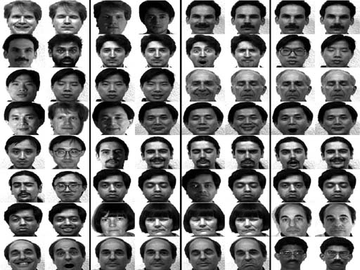
Eigenfaces
Yale Faces database is 320x243 grayscale
15 people, 11 pictures per person
[http://www.cs.princeton.edu/~cdecoro/eigenfaces/]

Slide 18
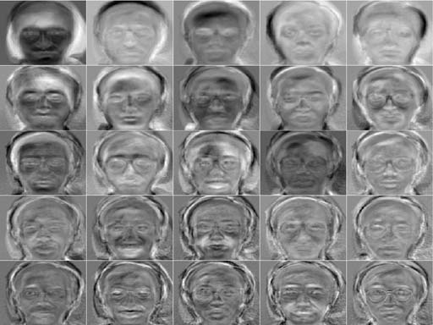
Eigenfaces

Slide 19
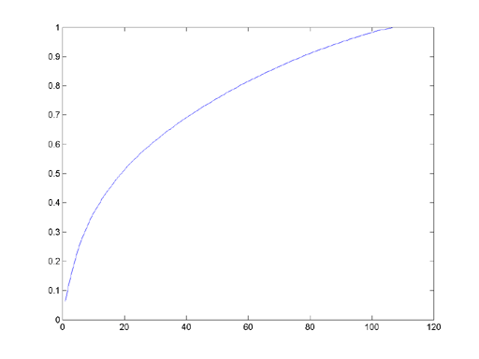
Eigenfaces
How much of the variation is captured by each principle component?

Slide 20
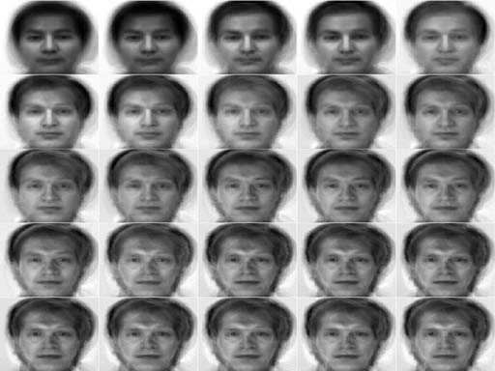
Eigenfaces
Once PC at a time…

Slide 21
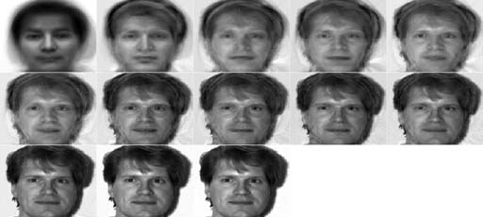
Eigenfaces
Eight PCs at a time

Slide 22
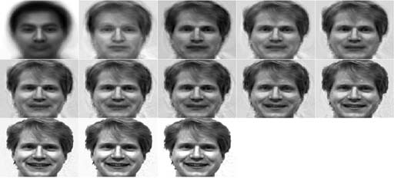
Eigenfaces
Excluding Glasses

Slide 23
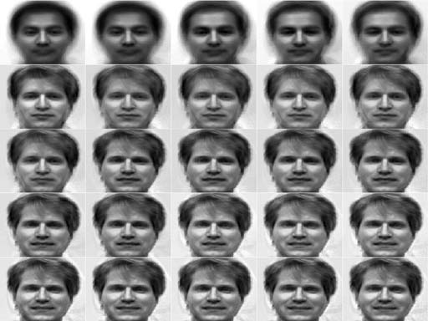
Eigenfaces
Excluding glasses and different lighting

Slide 24
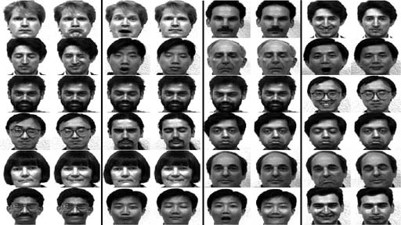
Eigenfaces
Results with no glasses and single lighting

Slide 25
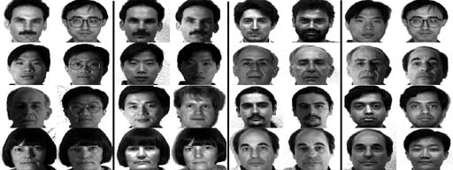
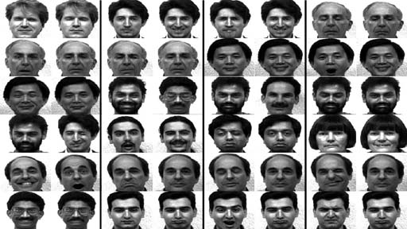
Eigenfaces
Lighting vs. Expression

Slide 26
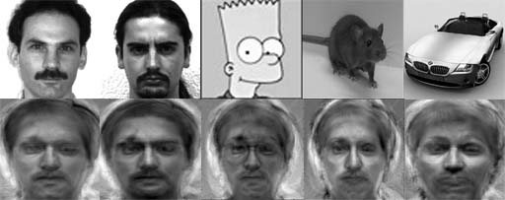
Eigenfaces
Non-faces

Slide 27
PCA
This means the error is given by

Slide 28
PCA Algorithm
This is fine when the input dimensionality is not too big
What about image data?
|Σ|=d×d Oh no!
Singular Value Decomposition (SVD)!
Available in Matlab (and elsewhere)

Slide 29
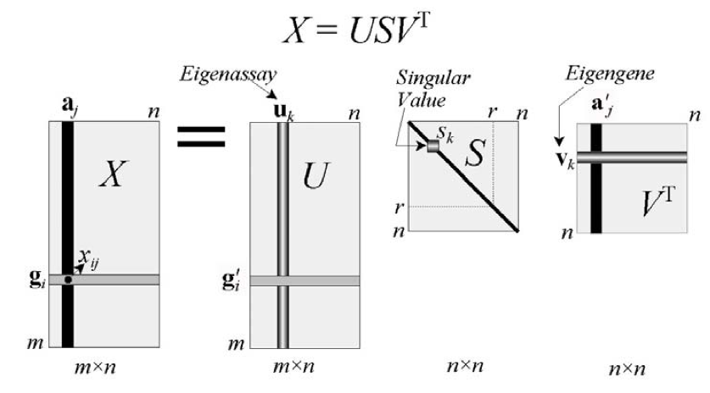
SVD
Data X, one row per data instance
US provides coordinates of rows of X in PC space
S is diagonal where S_{k}² is k^{th} largest eigenvalue
Rows of V^{T} are unit length eigenvectors of X^{T}X
[Wall et al., 2003]
Notes:
If columns of X have zero mean, then XTX = c \sigma and VT are the PCs

Slide 30
SVD
To project x onto r PCs, just take first r coordinates of V^{T}x

Slide 31
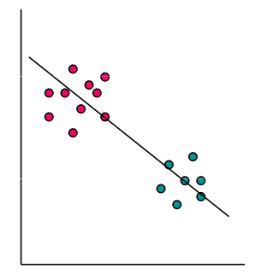
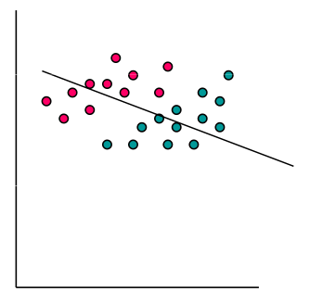
Supervised Dimensionality Reduction
[Tom Mitchell]

Slide 32
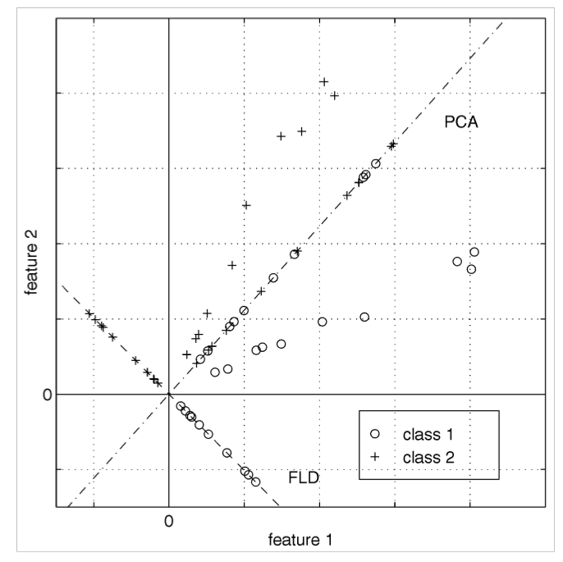
Another Example

Slide 33
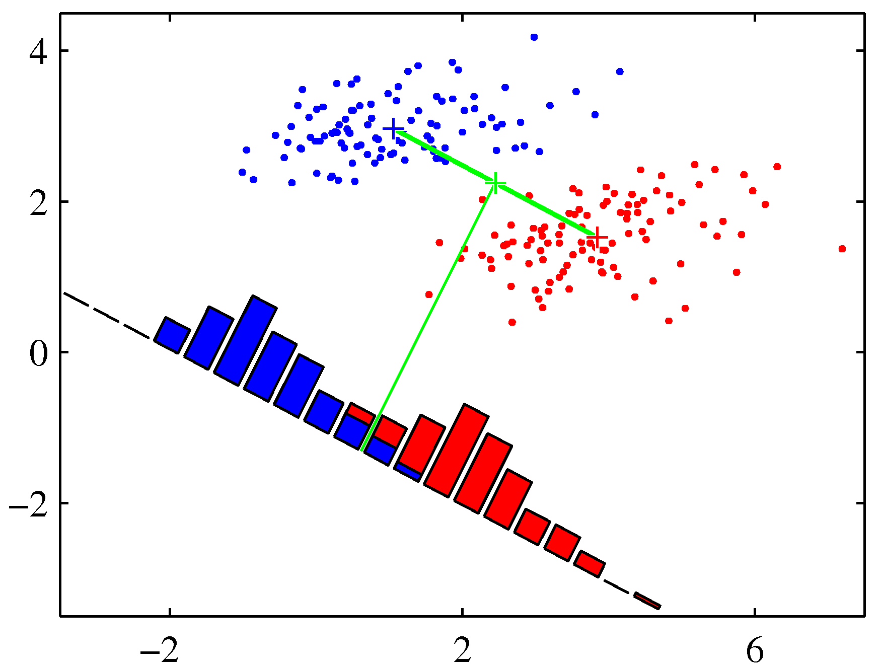
Fisher Linear Discriminant
Consider the mean vectors of a binary classification problem
Constrain
Need a separation criteria

Slide 34
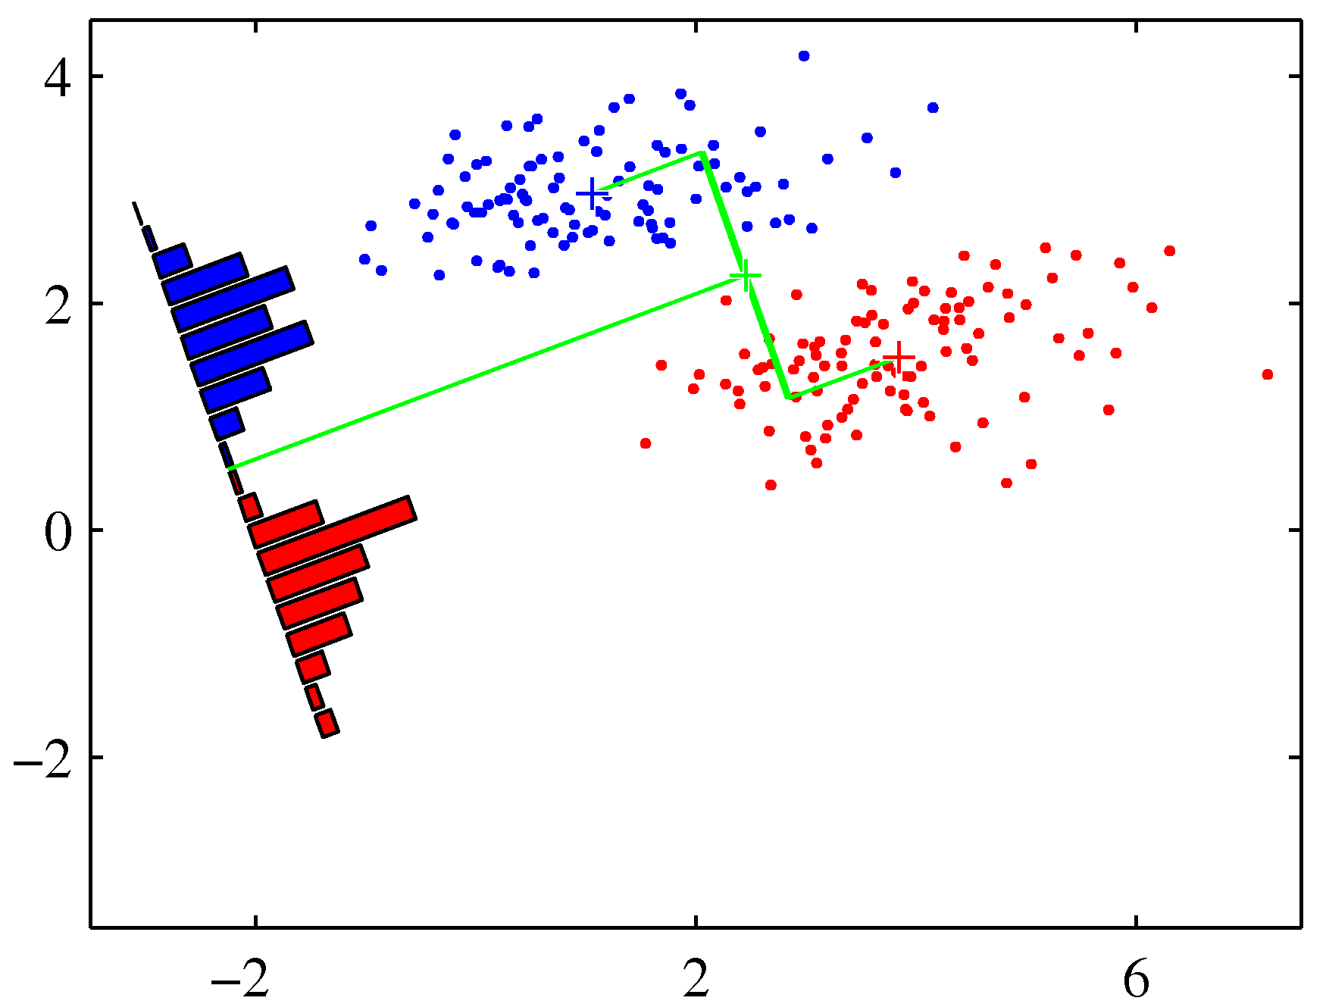
Fisher Linear Discriminant
Consider the distribution variances
Fisher Criterion

Slide 35
Fisher Linear Discriminant
Is the ratio of between-class variance to the within-class variance
where
Within-class covariance (“scatter”)
Between-class covariance (“scatter”)

Slide 36
Fisher Linear Discriminant
Differentiating J(w) w.r.t. w, maximized when
Don’t care about (w^{T}S_{B}w) or (w^{T}S_{W}w) as there are just scaling factors
Also, S_{B}w is always in direction of (m₂-m₁)
A Generalized Eigenvalue Problem

Slide 37
Fisher Linear Discriminant
Coverts d-dimensional problem to 1-D problem according to a satisfying intuition
Easy to turn into a classifier
If two classes generated normally with the same covariance, solution is optimal
Often unsatisfactory for data that does not resemble a normal distribution

Slide 38
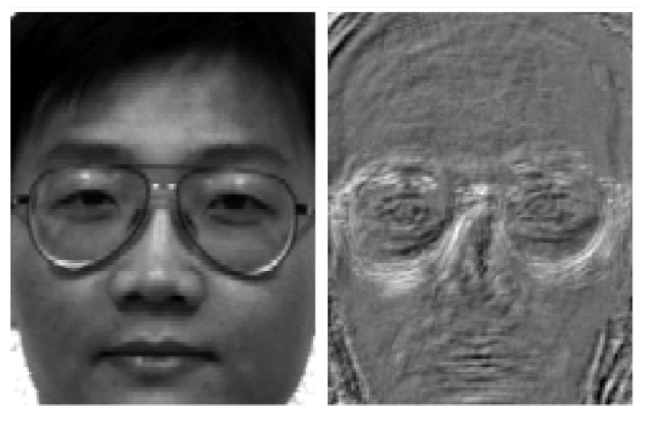
Fisherfaces
Dimensions particular to discriminative features
Works notably better for lighting – and also for expression differences

Slide 39
What you should know?
Feature Selection
Single feature scoring criteria
Search strategies based on cross-validation
Unsupervised Dimensionality Reduction
Principle Components Analysis (PCA)
Singular Value Decomposition (SVD)
Efficient PCA
Supervised Dimensionality Reduction
Fisher Linear Discriminant

Slide 40
So much more…
Independent Components Analysis
Canonical Correlation Analysis
Multidimensional Scaling
ISOMAP
Self-organizing Maps
Local Linear Embedding
Hessian/Laplacian Eigenmaps
Charting
The meaning of life…

