Slide 1
CS 5600
Computer Systems
Lecture 5: Synchronization, Deadlock

Slide 2
Motivating Parallelism
Synchronization Basics
Types of Locks and Deadlock

Slide 3
Concurrency vs. Parallelism
Concurrent execution on a single-core system:
Parallel execution on a dual-core system:
Core 1
P1 | P2 | P3 | P4 | P1 | P2 | P3 | P4 | P1 | …
Time
Core 1
P1 | P3 | P1 | P3 | P1 | P3 | P1 | P3 | P1 | …
Core 2
P2 | P4 | P2 | P4 | P2 | P4 | P2 | P4 | P2 | …
Time

Slide 4
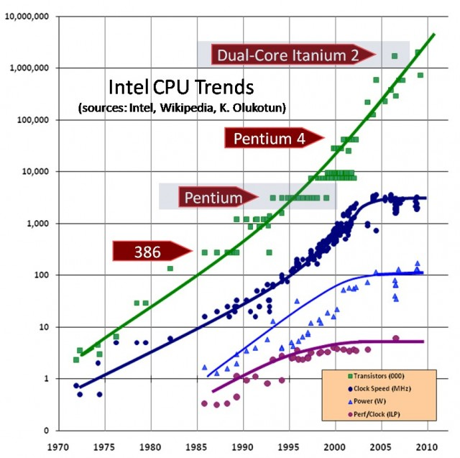
Transistors
Clock Speed
Power Draw
Perf/Clock

Slide 5
Implications of CPU Evolution
Increasing transistor count/clock speed
  Greater number of tasks can be executed concurrently
However, clock speed increases have essentially stopped in the past few years
  Instead, more transistors = more CPU cores
  More cores = increased opportunity for parallelism

Slide 6
Two Types of Parallelism
Data parallelism
  Same task executes on many cores
  Different data given to each task
  Example: MapReduce
Task parallelism
  Different tasks execute on each core
  Example: any high-end videogame
    1 thread handles game AI
    1 thread handles physics
    1 thread handles sound effects
    1+ threads handle rendering

Slide 7
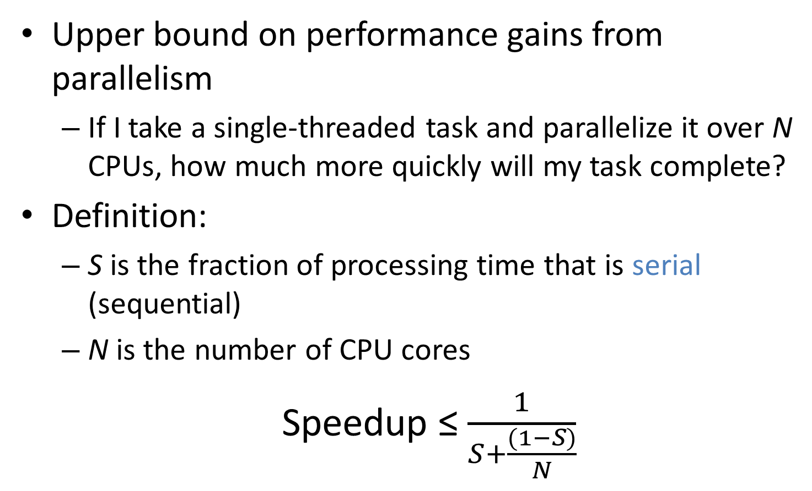
Amdahl’s Law
Upper bound on performance gains from parallelism
  If I take a single-threaded task and parallelize it over N CPUs, how much more quickly will my task complete?
Definition:
  S is the fraction of processing time that is serial (sequential)
  N is the number of CPU cores
  Speedup ≤ $\frac{1}{S+\frac{(1−S)}{N}}$

Slide 8
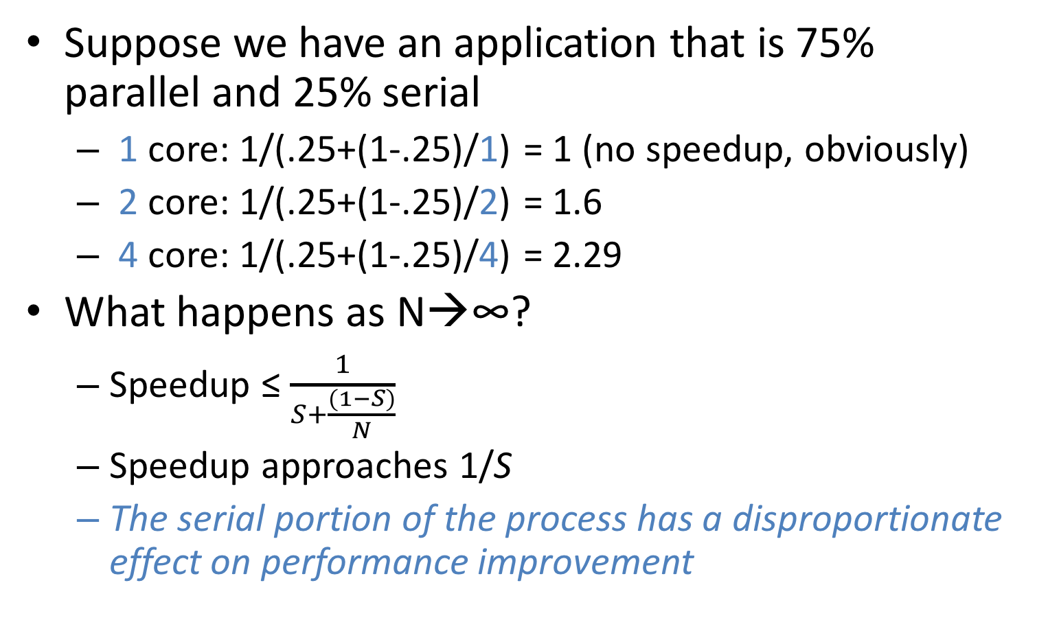
Example of Amdahl’s Law
Suppose we have an application that is 75% parallel and 25% serial
  1 core: 1/(.25+(1-.25)/1) = 1 (no speedup, obviously)
  2 core: 1/(.25+(1-.25)/2) = 1.6
  4 core: 1/(.25+(1-.25)/4) = 2.29
What happens as N→∞?
  Speedup ≤
  Speedup approaches 1/S
  The serial portion of the process has a disproportionate effect on performance improvement

Slide 9
Limits of Parallelism
Amdahl’s Law is a simplification of reality
  Assumes code can be cleanly divided into serial and parallel portions
  In other words, trivial parallelism
Real-world code is typically more complex
  Multiple threads depend on the same data
  In these cases, parallelism may introduce errors
Real-world speedups are typically < what is predicted by Amdahl’s Law

Slide 10
Motivating Parallelism
Synchronization Basics
Types of Locks and Deadlock

Slide 11
The Bank of Lost Funds
Consider a simple banking application
  Multi-threaded, centralized architecture
  All deposits and withdrawals sent to the central server
class account {
private money_t balance;
public deposit(money_t sum) {
  balance = balance + sum;
}
}
What happens if two people try to deposit money into the same account at the same time?

Slide 12
  balance = balance + sum;
mov eax, balance
mov ebx, sum
add eax, ebx
mov balance, eax
balance
eax = $50
$50
eax = $100
Thread 1
Thread 2
deposit($50)
mov eax, balance
mov ebx, sum
Context Switch
deposit($100)
mov eax, balance
mov ebx, sum
add eax, ebx
mov balance, eax
add eax, ebx
mov balance, eax
Context Switch

Slide 13
Race Conditions
The previous example shows a race condition
  Two threads “race” to execute code and update shared (dependent) data
  Errors emerge based on the ordering of operations, and the scheduling of threads
  Thus, errors are nondeterministic

Slide 14
Example: Linked List
elem = pop(&list):
  tmp = list
  list = list->next
  tmp->next = NULL
  return tmp
push(&list, elem):
  elem->next = list
  list = elem
What happens if one thread calls pop(), and another calls push() at the same time?
Thread 1 |  | Thread 2
1. tmp = list
 |  | 2. elem->next = list
3. list = list->next
 |  | 4. list = elem
5. tmp->next = NULL
1. tmp
3. list
0. list
1
2
3
∅
4. list
5. ∅
2. elem
4

Slide 15
Critical Sections
These examples highlight the critical section problem
Classical definition of a critical section:
“A piece of code that accesses a shared resource that must not be concurrently accessed by more than one thread of execution.”
Two problems
  Code was not designed for concurrency
  Shared resource (data) does not support concurrent access

Slide 16
Atomicity
Race conditions lead to errors when sections of code are interleaved
These errors can be prevented by ensuring code executes atomically
(a)
(b)
Read
Read
Read
Read
Add
Add
Add
Store
Store
Add
Read
Read
Add
Add
Store
Store
Store
Store
Interleaved Execution
Non-Interleaved (Atomic) Execution

Slide 17
Mutexes for Atomicity
Mutual exclusion lock (mutex) is a construct that can enforce atomicity in code
Thread 1
Thread 2
m = mutex_create();
…
mutex_lock(m);
// do some stuff
mutex_unlock(m);
mutex_lock(m)
critical
section
(returns)
unlock(m)
blocked
(returns)
(returns)
critical
section

Slide 18
Fixing the Bank Example
Thread 1
Thread 2
class account {
mutex m;
money_t balance
public deposit(money_t sum) {
m.lock();
balance = balance + sum;
m.unlock();
}
}
LOCK
Read
LOCK
Add
Store
UNLOCK
Read
Add
Store
UNLOCK

Slide 19
Implementing Mutual Exclusion
Typically, developers don’t write their own locking-primitives
  You use an API from the OS or a library
Why don’t people write their own locks?
  Much more complicated than they at-first appear
  Very, very difficult to get correct
  May require access to privileged instructions
  May require specific assembly instructions
    Instruction architecture dependent

Slide 20
Mutex on a Single-CPU System
void sema_down(struct semaphore * sema) {
enum intr_level old_level;
old_level = intr_disable();
while (sema->value == 0) { /* wait */ }
sema->value--;
intr_level(old_level);
}
void lock_acquire(struct lock * lock) {
sema_down(&lock->semaphore);
lock->holder = thread_current();
}
On a single-CPU system, the only preemption mechanism is interrupts
  If interrupts are disabled, the currently executing code is guaranteed to be atomic
This system is concurrent, but not parallel

Slide 21
The Problem With Multiple CPUs
In a multi-CPU (SMP) system, two or more threads may execute in parallel
  Data can be read or written by parallel threads, even if interrupts are disabled
sema->value = 1
CPU 1 - Thread 1
CPU 2 - Thread 2
sema_down() {
sema_down() {
while (sema->value == 0) { … }
while (sema->value == 0) { … }
sema->value--;
sema->value--;
}
}
sema->value = ?
21

Slide 22
Instruction-level Atomicity
Modern CPUs have atomic instruction(s)
  Enable you to build high-level synchronized objects
On x86:
  The lock prefix makes an instruction atomic
lock inc eax ; atomic increment
  lock dec eax ; atomic decrement
    Only legal with some instructions
  The xchg instruction is guaranteed to be atomic
    xchg eax, [addr] ; swap eax and the value in memory

Slide 23
Behavior of xchg
Non-Atomic xchg
Atomic xchg
CPU 1
memory
CPU 2
CPU 1
memory
CPU 2
eax: 1
1
0
0
0
0
1
1
1
eax: 2
2
0
0
0
1
2
2
eax: 1
1
0
0
eax: 2
2
1
xchg
xchg
xchg
xchg
Illegal execution
Legal execution
Atomicity ensures that each xchg occurs before or after xchgs from other CPUs

Slide 24
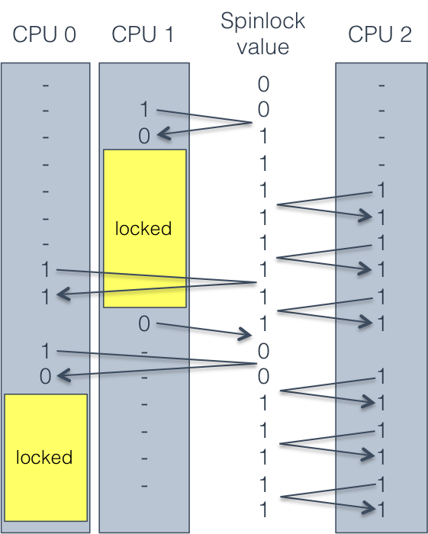
Building a Spin Lock with xchg
spin_lock:
mov eax, 1
xchg eax, [lock_addr]
test eax, eax
jnz spin_lock
spin_unlock:
mov [lock_addr], 0
CPU 1 locks.
CPUs 0 and 2 both try to lock, but cannot.
CPU 1 unlocks.
CPU 0 locks, simply because it requested it slightly before CPU 2.

Slide 25
Building a Multi-CPU Mutex
typedef struct mutex_struct {
  int spinlock = 0; // spinlock variable
  int locked = 0; // is the mutex locked? guarded by spinlock
  queue waitlist; // waiting threads, guarded by spinlock
  } mutex;
void mutex_lock(mutex * m) {
spin_lock(&m->spinlock);
    if (!m->locked){
        m->locked = 1;
        spin_unlock(&m->spinlock);
      } else {
        m->waitlist.add(current_process);
        spin_unlock(&m->spinlock);
        yield();
        // wake up here when the mutex is acquired
      }
    }

Slide 26
Building a Multi-CPU Mutex
typedef struct mutex_struct {
  int spinlock = 0; // spinlock variable
  int locked = 0; // is the mutex locked? guarded by spinlock
  queue waitlist; // waiting threads, guarded by spinlock
  } mutex;
void mutex_unlock(mutex * m) {
  spin_lock(&m->spinlock);
  if (m->waitlist.empty()) {
    m->locked = 0;
    spin_unlock(&m->spinlock);
    } else {
    next_thread = m->waitlist.pop_from_head();
    spin_unlock(&m->spinlock);
    wake(next_thread);
    }
    }

Slide 27
Compare and Swap
Sometimes, literature on locks refers to compare and swap (CAS) instructions
  CAS instructions combine an xchg and a test
On x86, known as compare and exchange
    spin_lock:
    mov ecx, 1
    mov eax, 0
    lock cmpxchg ecx, [lock_addr]
    jnz spinlock
      cmpxchg compares eax and the value of lock_addr
      If eax == [lock_addr], swap ecx and [lock_addr]

Slide 28
The Price of Atomicity
Atomic operations are very expensive on a multi-core system
  Caches must be flushed
    CPU cores may see different values for the same variable if they have out-of-date caches
    Cache flush can be forced using a memory fence (sometimes called a memory barrier)
  Memory bus must be locked
    No concurrent reading or writing
  Other CPUs may stall
    May block on the memory bus or atomic instructions

Slide 29
Motivating Parallelism
Synchronization Basics
Types of Locks and Deadlock
Lock-Free Data Structures

Slide 30
Other Types of Locks
Mutex is perhaps the most common type of lock
But there are several other common types
  Semaphore
  Read/write lock
  Condition variable
    Used to build monitors

Slide 31
Semaphores
Generalization of a mutex
  Invented by Edsger Dijkstra
  Associated with a positive integer N
  May be locked by up to N concurrent threads
Semaphore methods
  wait() – if N > 0, N--; else sleep
  signal() – if waiting threads > 0, wake one up; else N++

Slide 32
The Bounded Buffer Problem
Canonical example of semaphore usage
  Some threads produce items, add items to a list
  Some threads consume items, remove items from the list
  Size of the list is bounded
class semaphore_bounded_buffer:
mutex m
list buffer
semaphore S_space = semaphore(N)
semaphore S_items = semaphore(0)
put(item):
S_space.wait()
m.lock()
buffer.add_tail(item)
m.unlock()
S_items.signal()
get():
S_items.wait()
m.lock()
result = buffer.remove_head()
m.unlock()
S_space.signal()
return result

Slide 33
Example Bounded Buffer
buffer | S_items | S_space
[] | 0 | 2
[a] | 1 | 1
[a, b] | 2 | 0
[b] | 1 | 1
[b, c] | 2 | 0
Thread 1 | Thread 2 | Thread 3 | Thread 4
put(a)
 | put(b)
 |  | put(c)
 |  |  | get()

Slide 34
Read/Write Lock
Sometimes known as a shared mutex
  Many threads may hold the read lock in parallel
  Only one thread may hold the write lock at a time
    Write lock cannot be acquired until all read locks are released
    New read locks cannot be acquired if a writer is waiting
Ideal for cases were updates to shared data are rare
  Permits maximum read parallelization

Slide 35
Example Read/Write Lock
list | readers | writers
[a, b] | 0 | 0
[a, b] | 1 | 0
[a, b] | 2 | 0
[a, b] | 1 | 0
[a, b] | 0 | 0
[a, b] | 0 | 1
[a, b, c] | 0 | 1
[a, b, c] | 0 | 0
[a, b, c] | 1 | 0
[a, b, c] | 1 | 0
Thread 1 | Thread 2 | Thread 3
lock_r()
 | lock_r()
 |  | lock_w()
unlock_r()
 | unlock_r()
lock_r()
 |  | unlock_w()

Slide 36
When is a Semaphore Not Enough?
class weighted_bounded_buffer:
mutex m
list buffer
int totalweight
get(weight):
while (1):
m.lock()
if totalweight >= weight:
result = buffer.remove_head()
totalweight -= result.weight
m.unlock()
return result
else:
m.unlock()
yield()
put(item):
m.lock()
buffer.add_tail(item)
totalweight += item.weight
m.unlock()
No guarantee the condition will be satisfied when this thread wakes up
Lots of useless looping :(
In this case, semaphores are not sufficient
  weight is an unknown parameter
  After each put(), totalweight must be checked

Slide 37
Condition Variables
Construct for managing control flow amongst competing threads
  Each condition variable is associated with a mutex
  Threads that cannot run yet wait() for some condition to become satisfied
  When the condition is satisfied, some other thread can signal() to the waiting thread(s)
Condition variables are not locks
  They are control-flow managers
  Some APIs combine the mutex and the condition variable, which makes things slightly easier

Slide 38
Condition Variable Example
class weighted_bounded_buffer:
mutex m
condition c
list buffer
int totalweight = 0
int neededweight = 0
get(weight):
m.lock()
if totalweight < weight:
neededweight += weight
c.wait(m)
neededweight -= weight
result = buffer.remove_head()
totalweight -= result.weight
m.unlock()
return result
put(item):
m.lock()
buffer.add_tail(item)
totalweight += item.weight
if totalweight >= neededweight
and neededweight > 0:
c.signal(m)
else:
m.unlock()
signal() hands the locked mutex to a waiting thread
wait() unlocks the mutex and blocks the thread
When wait() returns, the mutex is locked
In essence, we have built a construct of the form:
  wait_until(totalweight >= weight)

Slide 39
Monitors
Many textbooks refer to monitors when they discuss synchronization
  A monitor is just a combination of a mutex and a condition variable
There is no API that gives you a monitor
  You use mutexes and condition variables
  You have to write your own monitors
    In OO design, you typically make some user-defined object a monitor if it is shared between threads
Monitors enforce mutual exclusion
  Only one thread may access an instance of a monitor at any given time
  synchronized keyword in Java is a simple monitor

Slide 40
Be Careful When Writing Monitors
Original Code
Modified Code
get(weight):
m.lock()
if totalweight < weight:
neededweight += weight
c.wait(m)
neededweight -= weight
result = buffer.remove_head()
totalweight -= result.weight
m.unlock()
return result
put(item):
m.lock()
buffer.add_tail(item)
totalweight += item.weight
if totalweight >= neededweight
and neededweight > 0:
c.signal(m)
else:
m.unlock()
get(weight):
m.lock()
if totalweight < weight:
neededweight += weight
c.wait(m)
result = buffer.remove_head()
totalweight -= result.weight
m.unlock()
return result
put(item):
m.lock()
buffer.add_tail(item)
totalweight += item.weight
if totalweight >= neededweight
and neededweight > 0:
c.signal(m)
neededweight -= item.weight
else:
m.unlock()
Incorrect! The mutex is not locked at this point in the code

Slide 41
Pthread Synchronization API
Mutex
Condition Variable
pthread_mutex_t m;
pthread_mutex_init(&m, NULL);
pthread_mutex_lock(&m);
pthread_mutex_trylock(&m);
pthread_mutex_unlock(&m);
pthread_mutex_destroy(&m);
pthread_rwlock_t rwl;
pthread_rwlock_init(&rwl, NULL);
pthread_rwlock_rdlock(&rwl);
pthread_rwlock_wrlock(&rwl);
pthread_rwlock_tryrdlock(&rwl);
pthread_rwlock_trywrlock(&rwl);
pthread_rwlock_unlock(&rwl);
pthread_rwlock_destroy(&rwl);
pthread_cond_t c;
pthread_cond_init(&c, NULL);
pthread_cond_wait(&c &m);
pthread_cond_signal(&c);
pthread_cond_broadcast(&c);
pthread_cond_destroy(&c);
sem_t s;
sem_init(&s, NULL, <value>);
sem_wait(&s);
sem_post(&s);
sem_getvalue(&s, &value);
sem_destroy(&s);
Read/Write Lock
POSIX Semaphore

Slide 42
Layers of Locks
mutex A mutex B | Thread 1 lock A lock B // do something unlock B unlock A | Thread 2 lock B lock A // do something unlock A unlock B
Thread 1 | Thread 2
lock(A)
lock(B)
unlock(B)
unlock(A)
 | lock(B)
 | lock(A)
 | unlock(A)
 | unlock(B)
Thread 1 | Thread 2
lock(A)
lock(B)
 | lock(B)
unlock(B)
unlock(A) | lock(A)
 | unlock(A)
 | unlock(B)
Thread 1 | Thread 2
lock(A) | lock(B)
lock(B) | lock(A)
Deadlock :(

Slide 43
When Can Deadlocks Occur?
Four classic conditions for deadlock
  Mutual exclusion: resources can be exclusively held by one process
  Hold and wait: A process holding a resource can block, waiting for another resource
  No preemption: one process cannot force another to give up a resource
  Circular wait: given conditions 1-3, if there is a circular wait then there is potential for deadlock
One more issue:
  Buggy programming: programmer forgets to release one or more resources

Slide 44
Circular Waiting
Simple example of circular waiting
  Thread 1 holds lock a, waits on lock b
  Thread 2 holds lock b, waits on lock a
Thread 1 | Thread 2
lock(A) | lock(B)
lock(B) | lock(A)
Thread 2
Lock A
Lock B
Thread 1

Slide 45
Avoiding Deadlock
If circular waiting can be prevented, no deadlocks can occur
Technique to prevent circles: lock ranking
  Locate all locks in the program
  Number the locks in the order (rank) they should be acquired
  Add assertions that trigger if a lock is acquired out-of-order
No automated way of doing this analysis
  Requires careful programming by the developer(s)

Slide 46
Lock Ranking Example
#1: mutex A #2: mutex B | Thread 1 lock A assert(islocked(A)) lock B // do something unlock B unlock A | Thread 2 assert(islocked(A)) lock B lock A // do something unlock A unlock B
Rank the locks
Add assertions to enforce rank ordering
In this case, Thread 2 assertion will fail at runtime

Slide 47
When Ranking Doesn’t Work
Example: Thread Safe List
In some cases, it may be impossible to rank order locks, or prevent circular waiting
In these cases, eliminate the hold and wait condition using trylock()
class SafeList {
method append(SafeList more_items){
  lock(self)
  lock(more_items)
Problem:
Safelist A, B
Thread 1: A.append(B)
Thread 2: B.append(A)
Solution: Replace lock() with trylock()
method append(SafeList more_items){
while (true) {
  lock(self)
  if (trylock(more_items) == locked_OK)
  break
  unlock(self)
  }
  // now both lists are safely locked

Slide 48
Motivating Parallelism
Synchronization Basics
Types of Locks and Deadlock

Slide 49
Beyond Locks
Mutual exclusion (locking) solves many issues in concurrent/parallel applications
  Simple, widely available in APIs
  (Relatively) straightforward to reason about
However, locks have drawbacks
  Priority inversion and deadlock only exist because of locks
  Locks reduce parallelism, thus hinder performance

Slide 50
Lock-Free Data Structures
Is it possible to build data structures that are thread-safe without locks?
  YES
Lock-free data structures
  Include no locks, but are thread safe
  However, may introduce starvation
    Due to retry loops (example in a few slides)

Slide 51
Wait-Free Data Structures
Wait-free data structures
  Include no locks, are thread safe, and avoid starvation
  Wait-free implies lock-free
    Wait-free is much stronger than lock-free
Wait-free structures are very hard to implement
  Impossible to implement for many data structures
  Often restricted to a fixed number of threads

Slide 52
Advantages of Going Lock-Free
Potentially much more performant than locking
  Locks necessitate waits, context switching, CPU stalls, etc…
Immune to thread killing
  If a thread dies while holding a lock, you are screwed
Immune to deadlock and priority inversion
  You can’t deadlock/invert when you have no locks :)

Slide 53
Caveats to Going Lock-Free
Very few standard libraries/APIs implement these data structures
  Implementations are often platform-dependent
  Rely on low-level assembly instructions
  Many structures are very new, not widely known
Not all data structures can be made lock-free
  For many years, nobody could figure out how to make a lock-free doubly linked list
Buyer beware if implementing yourself
  Very difficult to get right

Slide 54
Lock-free Queue Example: Enqueue
Usage: one reader, one writer
class Node {
Node * next;
int data;
};
// Queue pointers
volatile Node * first;
volatile Node * last;
volatile Node * divider;
lock_free_queue() {
// add the dummy node
first = last = divider
= new Node(0);
}
void enqueue(int& t) {
last->next = new Node(t);
last = last->next;
// garbage collect dequeued nodes
while (first != divider) {
Node * tmp = first;
first = first->next;
delete tmp;
}
}
Node 0
Node 1
Node 2
Node 3
first
divider
last

Slide 55
Lock-free Queue Example: Dequeue
Usage: one reader, one writer
class Node {
Node * next;
int data;
};
// Queue pointers
volatile Node * first;
volatile Node * last;
volatile Node * divider;
lock_free_queue() {
// add the dummy node
first = last = divider
= new Node(0);
}
bool dequeue(int& t) {
if (divider != last) {
t = divider->next->value;
divider = divider->next;
return true;
}
return false;
}
Node 0
Node 1
Node 2
Node 3
first
divider
last

Slide 56
Lock-free Queue Example: Enqueue
Usage: one reader, one writer
class Node {
Node * next;
int data;
};
// Queue pointers
volatile Node * first;
volatile Node * last;
volatile Node * divider;
lock_free_queue() {
// add the dummy node
first = last = divider
= new Node(0);
}
void enqueue(int& t) {
last->next = new Node(t);
last = last->next;
// garbage collect dequeued nodes
while (first != divider) {
Node * tmp = first;
first = first->next;
delete tmp;
}
}
Node 0
Node 1
Node 2
Node 3
Node 4
first
divider
last

Slide 57
Why Does This Work?
The enqueue thread and dequeue thread write different pointers
  Enqueue: last, last->next, first, first->next
  Dequeue: divider, divider->next
  Enqueue operations are independent of dequeue operations
  If these pointers overlap, then no work needs to be done
The queue always has >1 nodes (starting with the dummy node)

Slide 58
More Advanced Lock-Free Tricks
Many lock-free data structures can be built using compare and swap (CAS)
  bool cas(int * addr, int oldval, int newval) {
  if (*addr == oldval) { *addr = newval; return true; }
  return false;
  }
This can be done atomically on x86 using the cmpxchg instruction
Many compilers have built in atomic swap functions
  GCC: __sync_bool_compare_and_swap(ptr, oldval, newval)
  MSVC: InterlockedCompareExchange(ptr,oldval,newval)

Slide 59
Lock-free Stack Example: Push
Usage: any number of readers and writers
class Node {
Node * next;
int data;
};
// Root of the stack
volatile Node * head;
void push(int t) {
Node* node = new Node(t);
do {
node->next = head;
} while (!cas(&head, node->next, node));
}
head
Node 1
Node 2
Node 3
New Node 1

Slide 60
Lock-free Stack Example: Push
Usage: any number of readers and writers
class Node {
Node * next;
int data;
};
// Root of the stack
volatile Node * head;
void push(int t) {
Node* node = new Node(t);
do {
node->next = head;
} while (!cas(&head, node->next, node));
}
Thread 2
New Node 2
head
Node 1
Node 2
Node 3
New Node 1
Thread 1

Slide 61
Lock-free Stack Example: Pop
bool pop(int& t) {
Node* current = head;
while(current) {
if(cas(&head, current, current->next)) {
t = current->data;
delete current;
return true;
}
current = head;
}
return false;
}
class Node {
Node * next;
int data;
};
// Root of the stack
volatile Node * head;
current
head
Node 1
Node 2
Node 3

Slide 62
Retry Looping is the Key
Lock free data structures often make use of the retry loop pattern
  Read some state
  Do a useful operation
  Attempt to modify global state if it hasn’t changed (using CAS)
This is similar to a spinlock
  But, the assumption is that wait times will be small
  However, retry loops may introduce starvation
Wait-free data structures remove retry loops
  But are much more complicated to implement

Slide 63
Many Reads, Few Writes
Suppose we have a map (hashtable) that is:
  Constantly read by many threads
  Rarely, but occasionally written
How can we make this structure lock free?
  class readmap {
  mutex mtx;
  map<string, string> map;
  string lookup(const string& k) {
  lock l(mtx);
  return map[k];
  }
  void update(const string& k,
  const string& v) {
  lock lock(mtx);
  map[k] = v;
  }
  };

Slide 64
Duplicate and Swap
  class readmap {
  map<string, string> * map;
  readmap() { map = new map<string, string>(); }
  string lookup(const string& k) {
  return (*map)[k];
  }
  void update(const string& k, const string& v) {
  map<string, string> * new_map = 0;
  do {
  map<string, string> * old_map = map;
  if (new_map) delete new_map;
  // clone the existing map data
  new_map = new map<string, string>(*old_map);
  (*new_map)[k] = v;
  // swap the old map for the new, updated map!
  } while (cas(&map, old_map, new_map));
  }
  };

Slide 65
Memory Problems
What is the problem with the previous code?
  } while (cas(&map, old_map, new_map));
The old map is not deleted (memory leak)
Does this fix things?
  } while (cas(&map, old_map, new_map));
  delete old_map;
Readers may still be accessing the old map!
  Deleting it will cause nondeterministic behavior
Possible solution: store the old_map pointer, delete it after some time has gone by

Slide 66
Hazard Pointers
Construct for managing memory in lock-free data structures
Straightforward concept:
  Read threads publish hazard pointers that point to any data they are currently reading
  When a write thread wants to delete data:
    If it is not associated with any hazard pointers, delete it
    If it is associated with a hazard pointer, add it to a list
    Periodically go through the list and reevaluate the data
Of course, this is tricky in practice
  You need lock-free structures to:
    Enable publishing/updating hazard pointers
    Store the list of data blocked by hazards

Slide 67
The ABA Problem
Subtle problem that impacts many lock-free algorithms
Compare and swap relies on the uniqueness of pointers
  Example: cas(&head, current, current->next)
However, sometimes the memory manager will reuse pointers
  item * a = stack.pop();
  free a;
  item * b = new item();
  stack.push(b);
  assert(a != b); // this assertion may fail!

Slide 68
ABA Example
bool pop(int& t) {
Node* current = head;
while(current) {
if(cas(&head, current, current->next)) {
t = current->data;
delete current;
return true;
}
current = head;
}
return false;
}
Order of Events
Thread 1: pop() { current = head;
 | Thread 2: pop() {…}
 | Thread 2: push(int N) {…}
cas(...);
Thread 1: current
0x0F12: Node 4
0xA8B0: Node 3
head
0x0F12: Node 1
0x055D:Node 2

Slide 69
Applications of Lock-Free Structures
Stack
Queue
Deque
Linked list
Doubly linked list
Hash table
Many variations on each
  Lock free vs. wait free
Memory managers
  Lock free malloc() and free()
The Linux kernel
  Many key structures are lock-free

Slide 70
References
Geoff Langdale, Lock-free Programming
  http://www.cs.cmu.edu/~410-s05/lectures/L31_LockFree.pdf
Herb Sutter, Writing Lock-Free Code: A Corrected Queue
  http://www.drdobbs.com/parallel/writing-lock-free-code-a-corrected-queue/210604448

