Slide 1

Pivot tables and charts
Leena Razzaq lrazzaq@ccs.neu.edu
CS1100 Computer Science and its Applications

Slide 2
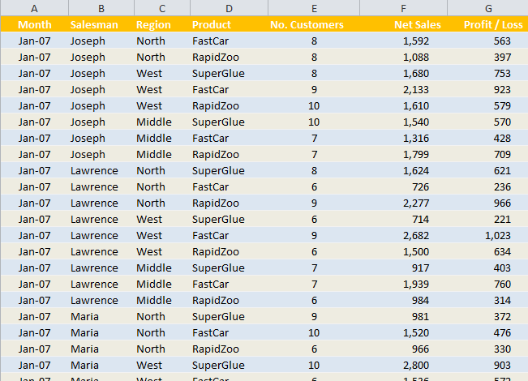
It’s difficult to see the bottom line in a flat list like this, turning the list into a Pivot Table will help.

Slide 3
Pivot Tables
So far we have been summarizing (filtering) data using IF statements.
Pivot tables are a much more powerful, “interactive” way to produce summaries.
  Can summarize information from selected fields of a data source.
  Pivot: rows can easily become columns, columns can easily become rows.

Slide 4
Examples
Summarizing data, i.e. finding average sales for each region for each product
Filtering, sorting, summarizing data without writing any formulas
Transposing data
Linking data sources

Slide 5
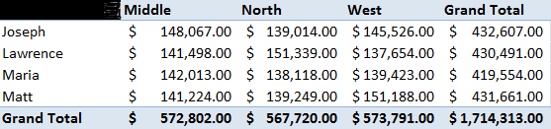

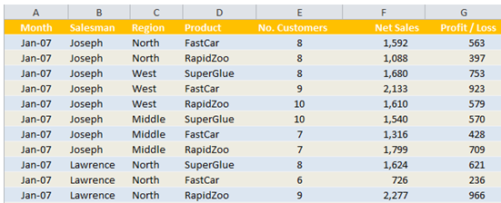

Organize your Data
Must be raw data, unprocessed and unsummarized
Each column should have a header.
The data should have no blank rows or columns
not raw data, already summarized

Slide 6
Pivot Table Setup
To create a pivot table, specify:
  Which fields you’re interested in
  How you want the table organized
  What kinds of calculations you want to perform
You can:
  Rearrange it to view from alternative perspectives
    “pivot” the dimensions – i.e. transpose column headings to row positions

Slide 7
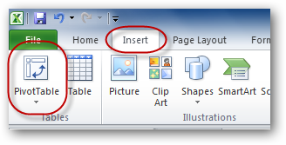
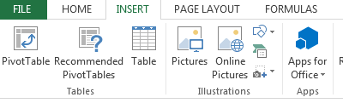
Creating Pivot Tables
Click on a cell from the table you want to summarize.
From the Insert tab, click the PivotTable icon

Slide 8
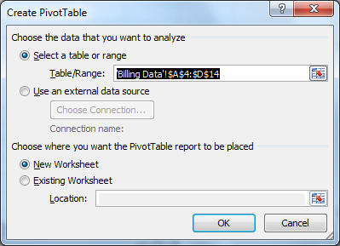
Creating Pivot Tables
Select the range you want to summarize and where you would like the pivot table to appear.

Slide 9
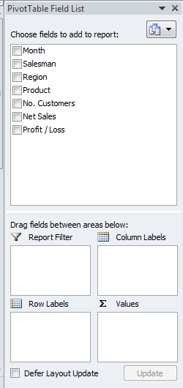
Creating a Pivot table
The PivotTable Field list is divided into sections.
You can drag and drop the fields you want in each area.
The body of the table will contain three parts: Rows, Columns and Cells. You can use any fields in these areas.

Slide 10
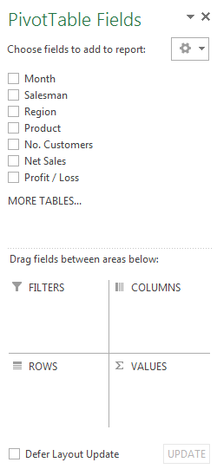
Creating a Pivot table
The PivotTable Field list is divided into sections.
You can drag and drop the fields you want in each area.
The body of the table will contain three parts: Rows, Columns and Cells. You can use any fields in these areas.

Slide 11
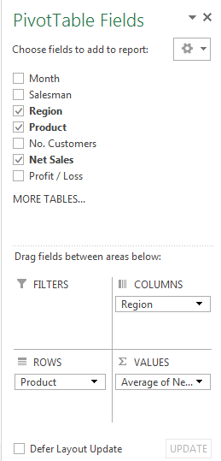
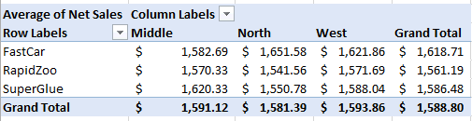

Slide 12
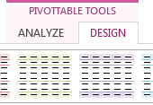
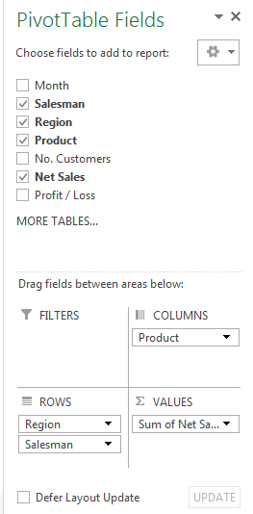
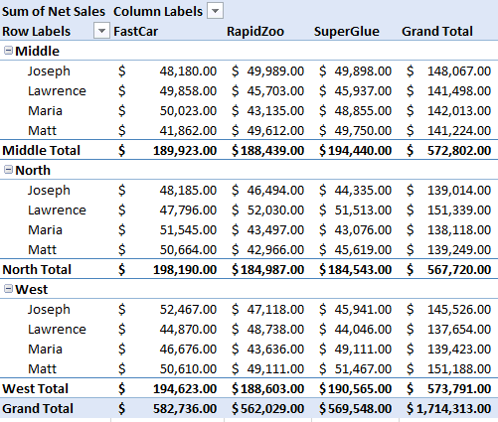
You can add subtotals, from the Design Tab under PivotTable Tools.
Order Matters!
Click the down arrow to change field settings and formatting

Slide 13
Same data, different story
The data is the same, only the perspective is different

Slide 14

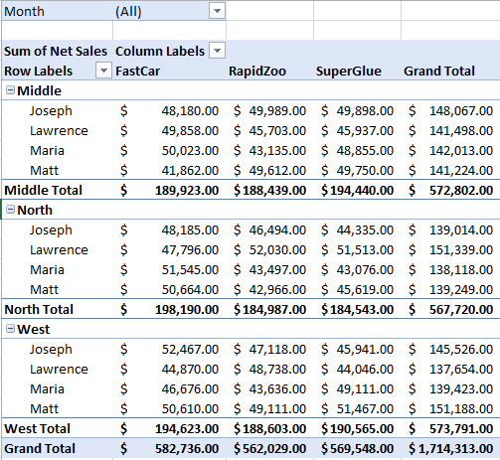
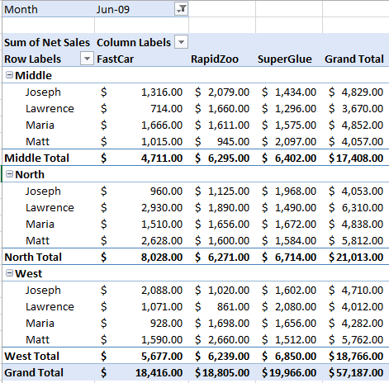
Add a Filter

Slide 15
Working with Dates
Often, there are many dates in a data set
Excel lets us group data items together by day, week, month, year...

Slide 16
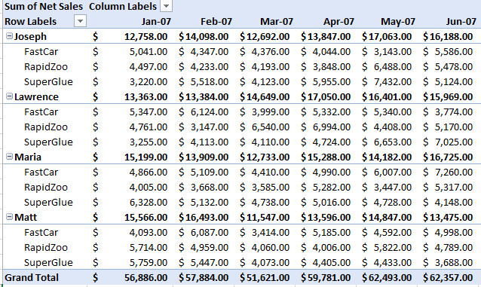
Working with Dates

Slide 17
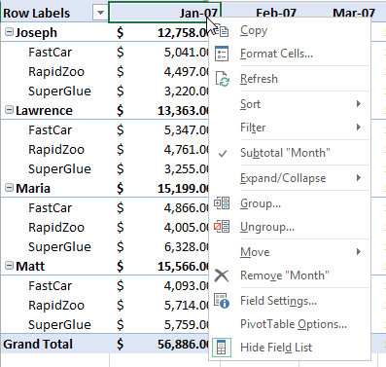
Working with Dates

Slide 18
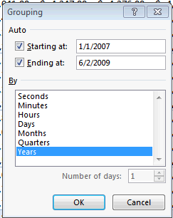
Working with Dates
Group sales by year

Slide 19
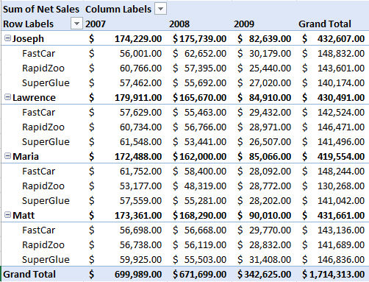
Working with Dates

Slide 20
Slicers
It is not easy to see the current filtering state when you filter on multiple items
Slicers are easy-to-use filtering components with buttons that enable you to quickly filter the data in a PivotTable, without opening drop-down lists to find the items that you want to filter.
In addition to quick filtering, slicers also indicate the current filtering state, which makes it easy to understand what exactly is shown in a filtered PivotTable report.

Slide 21
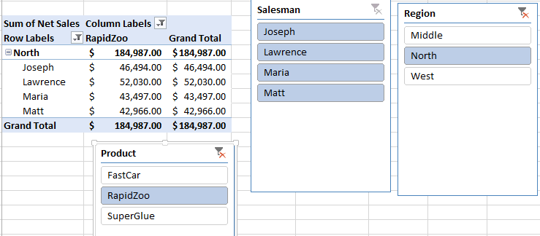
Slicers
Slicers allow us to quickly filter the table to show only the North region and the RapidZoo product for all Salesmen

Slide 22
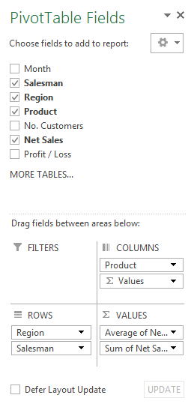
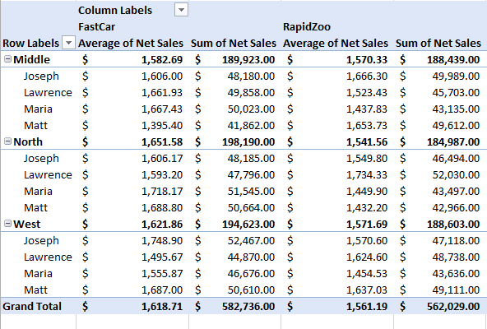
Multiple Summary Functions to the Same Field
Drag another copy of the field into the Values box.

Slide 23
Calculated Fields
In a pivot table, you can create a new field that performs a calculation on the sum of other pivot fields.
For example, we can create a calculated field named Bonus to calculate 3% of the Total Net Sales as a bonus for each salesperson.

Slide 24
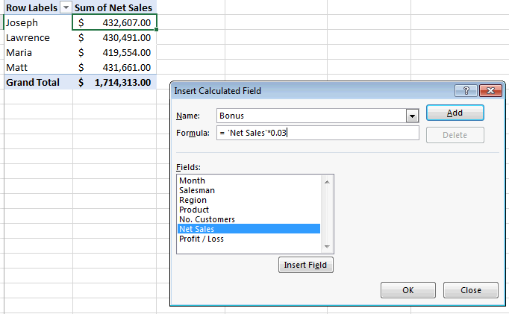
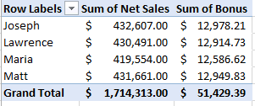
Calculate a Bonus for each Salesperson

Slide 25
About Calculated Fields
For calculated fields, the individual amounts in the other fields are summed, and then the calculation is performed on the total amount.
Calculated field formulas cannot refer to the Pivot table totals or subtotals
Calculated field formulas cannot refer to worksheet cells by address or by name.
Sum is the only function available for a calculated field.

Slide 26
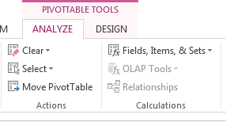
To add a calculated field:
Select a cell in the pivot table, and on the Excel Ribbon, under the PivotTable Tools tab, click the Analyze tab.
In the Calculations group, click Fields, Items & Sets, and then click Calculated Field. (Calculated fields can also be modified here.)
Type a name for the calculated field, for example, Bonus.
In the Formula box, type in the formula
Click Add to save the calculated field, and click Close. The Bonus field appears in the Values area of the pivot table, and in the field list in the PivotTable Field List.

Slide 27
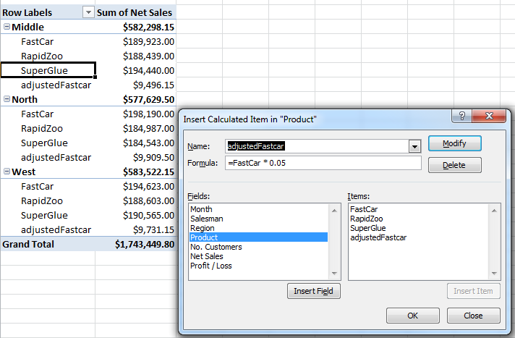
Calculated Items
A calculated item is a new item in an existing field
Derived from calculations performed on other items already in the field.
Example: the service plan for FastCar adds 5% to sales for the product. Create a new Calculated Item that calculates values for FastCar service plans.

Slide 28
Calculated Items Warnings
A field with a calculated item cannot be moved to the Report Filter area
Multiple copies of a field are not supported when a PT has calculated items.
A problem can occur when a calculated item or function defined in one pivot table is applied to other pivot tables in an Excel file causing a conflict.
This can be solved by making pivot tables that are based on the same source data independent.
  For instance, give the source data two different defined names and use one of the names for a PT with a calculated item and the other name for pivot tables without.

Slide 29
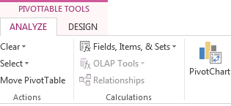
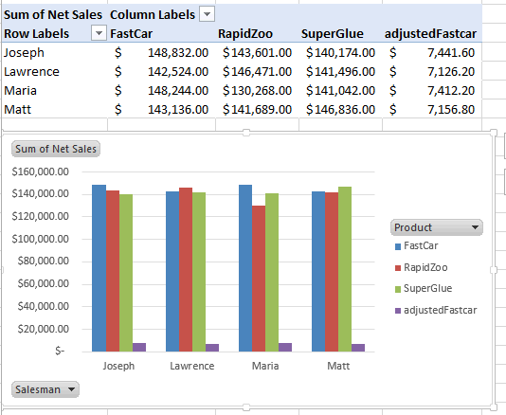
Pivot Charts
You can also make charts of summarized pivot table data.

Slide 30
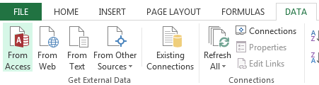
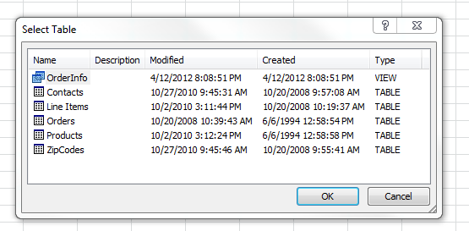
Create a Pivot Table from an Access Table
From the Data Menu, choose “From Access”
Find your Access file and choose the table or query to use in your pivot table.

Slide 31
Any Questions?

