Slide 1

CS1100: Computer Science and Its Applications
Creating Graphs and Charts in Excel

Slide 2

Charts
Data is often better explained through visualization as either a graph or a chart.
Excel makes creating charts easy:
  Column Charts
  Pie Charts
  Bar Graphs
  Line Graphs
  Area Graphs
  Scatter Plots

Slide 3
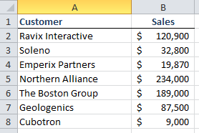
Sample Data
Here’s some sales data that we would like to visualize:

Slide 4
Pie Charts
A pie chart is useful when you are trying to show proportions.
How much of the sales revenue comes from each client?
Who are our largest clients?

Slide 5
The Chart Layout

Slide 6
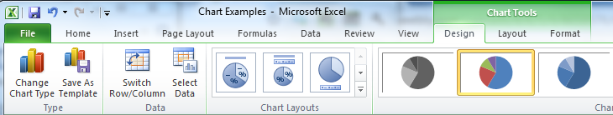
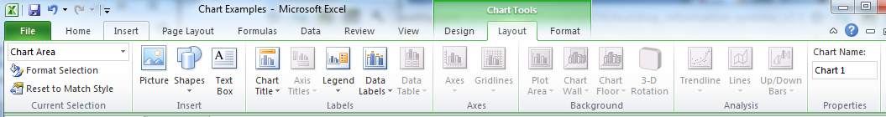
Customizing a Chart

Slide 7
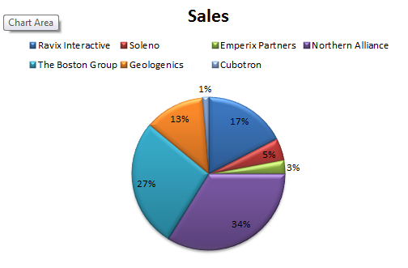

Slide 8
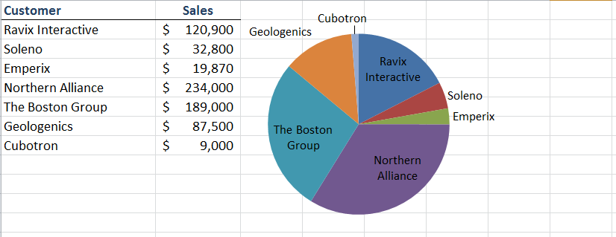
Transparency to Create a Minimal Display
Useful for creating a worksheet display that minimizes chart details and simply shows a small graphic to support a set of numbers

Slide 9
Column Chart
Also known as a bar chart, with rectangular bars of lengths usually proportional to the magnitudes or frequencies of what they represent.
The bars are vertically oriented in a column chart
Useful for showing data changes over a period of time, or illustrating comparisons
Categories organized on horizontal axis
Values on vertical axis

Slide 10
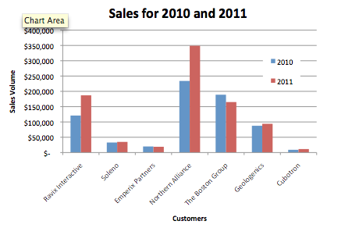
Column chart

Slide 11
Line Graph
Often used to plot changes in data over time such as weekly temperature changes or stock market prices
If plotting changes over time:
  Time is plotted along the horizontal or x-axis
  Data is plotted as individual points along the vertical axis

Slide 12
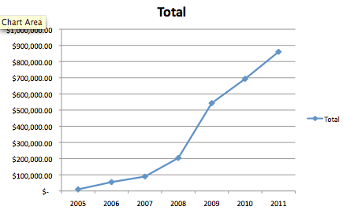
Line Graph

Slide 13
High Low Close Graph
Used to illustrate the fluctuation of stock prices or for scientific data
The data should be arranged with stock names as row headings, and High, Low and Close entered as column headings
In “Stock” Charts in Excel

Slide 14
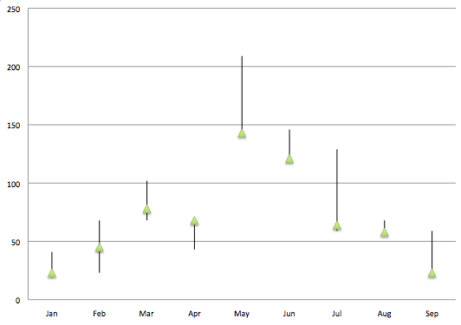
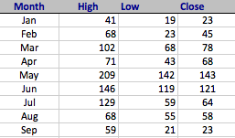
High Low Close

Slide 15
X/Y Scatter Plot
Useful for determining how things relate to one another e.g. profits vs. expenditures, height vs. weight, etc.
Each data point has more than one attribute
  Person (height, weight)
  Quarter (profit, expenditure)
Each attribute on single axis

Slide 16
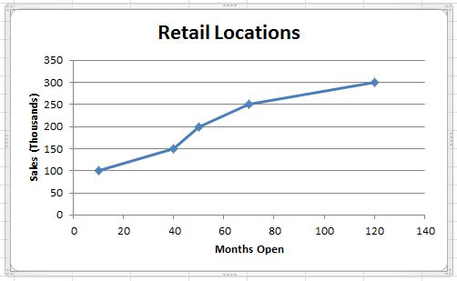
X/Y Scatter Plot

Slide 17
Assigning a Series to a Secondary Axis
A secondary value axis can make it easier to compare data series that have deviating ranges.
Example: a series showing number of units sold per year has a range that is much higher than cost per unit per year that it’s hard to see how they relate to each other. Putting one of the series on a secondary axis makes it possible to compare

Slide 18
Assigning a Series to a Secondary Axis
The line graph on the left shows two data series with widely differing ranges, so it’s hard to compare them.
The graph on the right plots one series on a secondary axis making it much easier to compare.
To move a series to a secondary axis, right-click on the series, click Format Data Series, select Series Options then select Secondary Axis.

Slide 19
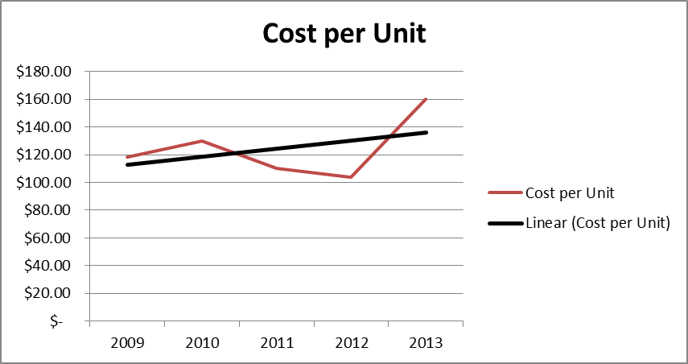
Trendlines, Error Bars, etc.
Excel also provides statistical analysis tools via the Layout tab / Analysis section.
  Trendlines show the “best fit” for the data.
  Error bars show “confidence intervals” around data points.

Slide 20
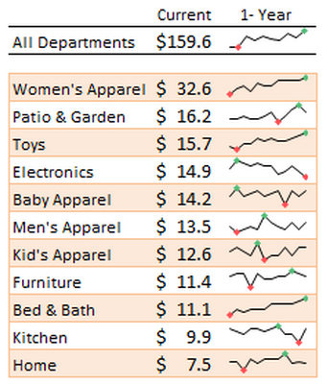
Sparklines
New to Excel 2010, we can also create charts or graphs that live within one cell
Their inventor, Edward Tufte, describes them as “intense, simple, word-sized graphics”
Meant to be embedded into what they are describing
Presents the general shape of variation in some measurement, in a simple and highly condensed way

Slide 21

To Create Sparklines:
Select the cell where you want the Sparkline to appear
Click the Insert tab and
look for the Sparklines group
Choose the data range and the location for the Sparkline.

Slide 22
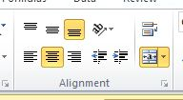
Merging Cells
To make sparklines bigger, you can merge multiple cells into a single cell.
  In the home tab:

Slide 23
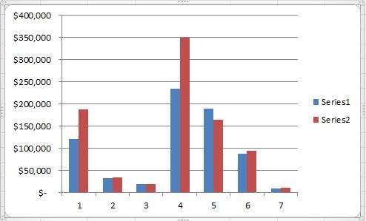
Common Issues: data labels
Data labeled “Series1”

Slide 24
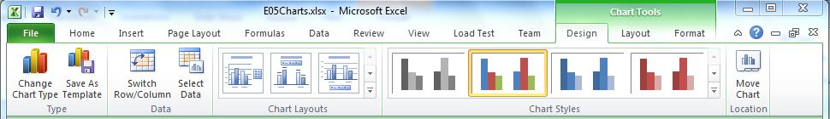
Common Issues: data labels
Data labeled “Series1”
To fix it: Select Data

Slide 25
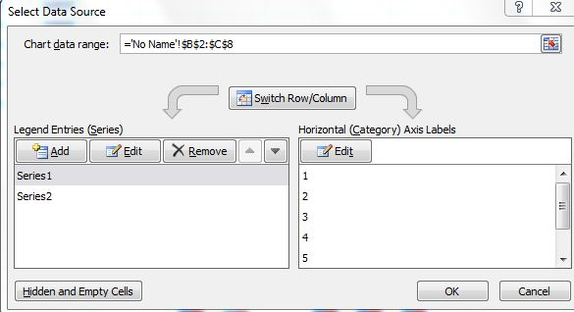
Common Issues: data labels
Data labeled “Series1”
To fix it: Select Data
  Edit Series Name

Slide 26
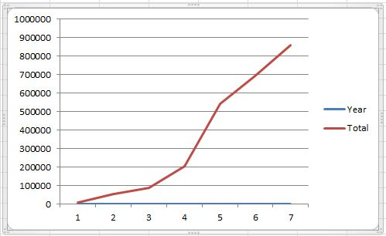
Common Issues: axis labels
Axis labels plotted instead

Slide 27
Common Issues: axis labels
Axis labels plotted instead
To fix it: Select Data

Slide 28
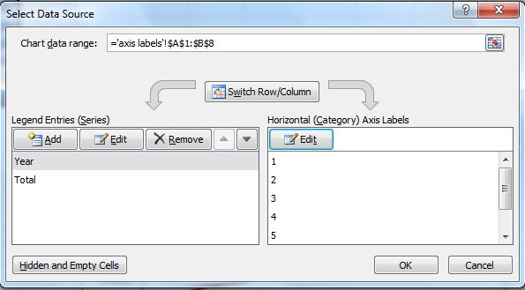
Common Issues: axis labels
Axis labels plotted instead
To fix it: Select Data
  Remove axis series
  Edit Axis Labels

Slide 29
Histograms
Histograms are a specialized type of bar graph used to summarize groups of data.
In some cases, you may collect a large number of data points for a single level of an independent variable.
  That is, you take the same measurement over and over again. For example, when a lack of precision in measuring process does not give a good estimate of the true value with only a single measurement.

Slide 30
Binning
How to summarize the results of these measurements?
One way might be to simply calculate the average of all these measurements.
  This would not, however, give you a good feel for how the data is distributed.
A distribution graph, or histogram, allows you to see how many measurements fall within set ranges, or bins, of the dependent variable.
  usually depicted as a bar chart, with one bar representing the count of how many measurements fall in a single bin.

Slide 31
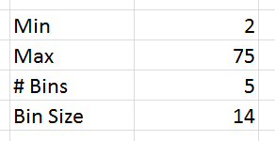
Set up bins
Find the minimum and maximum values of your data and the total range.
Pick the number of bins that you want to use. Think small.
Calculate the bin size: (Max – Min)/#bins and ROUNDDOWN to get a whole number

Slide 32
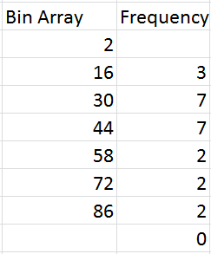
Set up bins
Set up the first bin in the Bin Array
The first bin will be Min + Bin Size
The next bin will be the previous Bin + Bin Size
Min value
1st Bin

Slide 33
Compute Frequencies
Use the FREQUENCY array function to fill in the data column. (Order of the steps is important)
First: select the range for the Frequency plus one extra cell (extra cell for values that are greater than the highest interval in the data_array.)
Second: type in the frequency function, =FREQUENCY(data_array, bin_array)
Third: press CTRL-SHIFT-ENTER for Windows, or CMD-ENTER on Mac

Slide 34
Compute Frequencies
# of values at <= 16
# of values > 16 and <= 30
# of values > 30 and <= 44

Slide 35
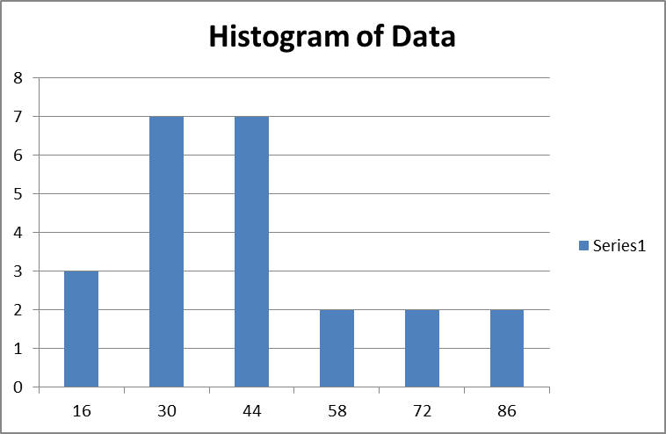
Plot Histogram - Frequency vs. Bin Data
Highlight the bin array and frequency numbers. Click on the icon for Column Chart.
Series: X values are bin values, Y is the frequency.
Add titles.

Slide 36
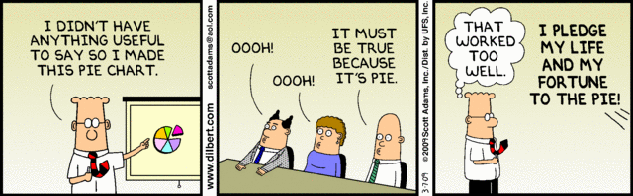
Any Question?

