Slide 1
CS1100: Computer Science and Its Applications
Table Lookup and Error Processing

Slide 2
Lookup and Mapping
Excel Basics

Slide 3
LOOKUP Tables
LOOKUP Tables help you use a worksheet table as a source of information to be used elsewhere in formulas.
Used to store data you want to refer to frequently.
Use a LOOKUP formula from other cells to look up data
Lookup formulas can work vertically, looking for values down a column, or they can work horizontally, looking for values across a row

Slide 4
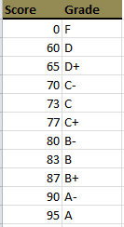
Consider This Example
Grades

Slide 5
Table Lookup
Given a score, we wish to look up the letter grade in this table.
VLOOKUP
Table is arranged as columns
Lookup value in column 1
Result value in column 2

Slide 6
VLOOKUP Table Setup Rules
The lookup value (key value) must be in the first column.
The key values can appear in any order

Slide 7
Table Lookup
There are two Excel functions for looking up values in a table:
VLOOKUP
Table is arranged as columns
HLOOKUP
Table is arranged as rows

Slide 8
VLOOKUP Parameters
General form of VLOOKUP:
VLOOKUP (lookup_value, table_array, col, [option])
Definitions of the VLOOKUP parameters:
lookup_value: value to be used as a key into the table_array
table_array: table of values where first column is key
col: column to be returned as value of VLOOKUP
option: FALSE (for now)

Slide 9
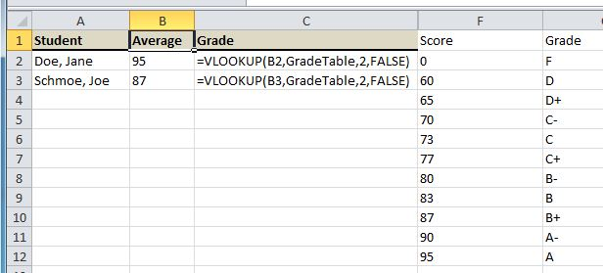
Using VLOOKUP
Value Column
Key Column

Slide 10
Consider This Example
Employee payroll data:
Job Status: full-time (FT) or part-time (PT)
Salary: annual compensation
Years Service: number of years employee has been with company
Life Ins: Y = employee wants life insurance, N = no life insurance
Health Plan: type of health plan employee participates in
Life Premium: amount of life insurance premium paid by employer
Health Premium: amount of health insurance premium paid by employer
Total Comp: total compensation paid to employee (salary + insurance)

Slide 11
Calculations
We need to calculate:
Life Insurance Premium
Health Insurance Premium
Total Compensation

Slide 12
Health Insurance Rules (an exact lookup)
The health insurance premium is based on the type of plan selected:
Plan Type | Premium
HMOF | $2,300 per month
HMOI | $1,040 per month
PPOF | $1,755 per month
PPOI | $897 per month
DISF | $457 per month

Slide 13
VLOOKUP Table Setup Rules
The lookup value (key value) must be in the first column.
For an exact match lookup, the key values can appear in any order.

Slide 14
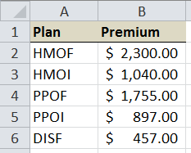
VLOOKUP Table Setup
Let’s start by building a lookup table to get the health insurance premium.
This table can optionally be turned into a named range for easier referencing.
Assignment: Turn range A2:B6 into the named range HealthRates
Lookup value in column 1
Result value in column 2

Slide 15
Using VLOOKUP
=VLOOKUP (F2, HealthRates, 2, FALSE)

Slide 16
HLOOKUP Table Setup
HLOOKUP is similar to VLOOKUP except that the table is set up horizontally:

Slide 17
HLOOKUP Parameters
General form of HLOOKUP:
HLOOKUP (lookup_value, table_array, row, [option])
Definitions of the HLOOKUP parameters:
lookup_value: value to be used as a key into the table_array
table_array: table of values where first row is key
row: row to be returned as value of HLOOKUP
option: FALSE (for now)

Slide 18
Using HLOOKUP
Using HLOOKUP is very similar to VLOOKUP:
=HLOOKUP (F2, HealthRates, 2, FALSE)

Slide 19
Range or Interval Lookups
So far we have looked up values that are either found in the lookup table or not.
Some applications require numeric intervals or ranges.
For example, in a grading model, grades are assigned to ranges of scores.
93 – 100 = A
90 – 92 = A-
and so forth

Slide 20
VLOOKUP Parameters
General form of VLOOKUP:
VLOOKUP (lookup_value, table_array, col, [option])
Definitions of the VLOOKUP parameters:
lookup_value: value to be used as a key into the table_array
table_array: table of values where first column is key
col: column to be returned as value of VLOOKUP
option: FALSE = exact match, TRUE = approximate (or interval/range) match

Slide 21
VLOOKUP Table Setup Rules
The lookup value (key value) must be in the first column.
For an exact match lookup, the key values can appear in any order
For an approximate (or range) lookup, the values must start with the smallest value

Slide 22
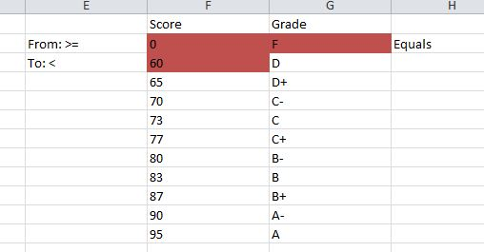
Setting up VLOOKUP Intervals

Slide 23
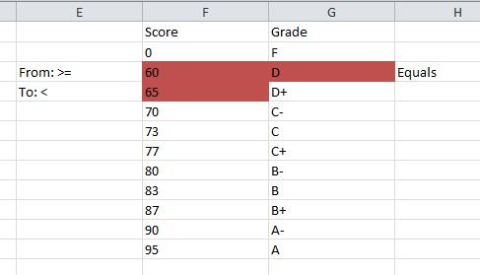
Setting up VLOOKUP Intervals

Slide 24
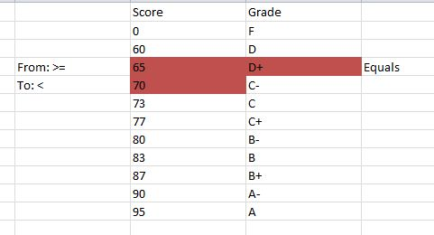
Setting up VLOOKUP Intervals

Slide 25
Life Insurance Rules (A range or interval lookup)
If the employee wants life insurance, then the premium is calculated as follows:
Insurance Rate is based on salary:
Under $50,000, premium is $250 per year
From $50,000 to under $70,000, premium is $350 per year
From $70,000 to under $90,000, premium is $475 per year
From $90,000 to under $110,000, premium is $545 per year

Slide 26
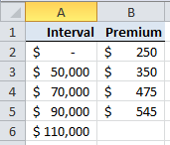
Setting up VLOOKUP Intervals
Insurance Rate is based on salary:
Under $50,000, premium is $250 per year
From $50,000 to $69,999, premium is $350 per year
From $70,000 to $89,999, premium is $475 per year
From $90,000 to $109,999, premium is $545 per year

Slide 27
Reading the VLOOKUP Table
An interval lookup table doesn’t need to contain both ends.
The table MUST start with the smallest value because the search stops once the value fits the range.
From
Value
To

Slide 28
Using VLOOKUP with Intervals
=IF(E2=“Y”, VLOOKUP (C2, LifeRates, 2, TRUE), 0)

Slide 29
Managing Errors
Excel Basics

Slide 30
Lookup Errors
What happens when VLOOKUP cannot find the value?
Returns error #N/A
Use IFERROR to detect errors and provide an alternative.

Slide 31
Catching Errors
Models can contain errors, such as:
Divide by 0
Lookup value not found
Substring not found
To test if a function returns an error, use IFERROR.

Slide 32
Using IFERROR
IFERROR works almost like IF, except that there’s no condition to test:
=IFERROR (value, value_if_error)
Using IFERROR with VLOOKUP:
=IFERROR (VLOOKUP(F2,HealthRates,2,FALSE), 0)

