Slide 1
CS1100: Computer Science and Its Applications
Excel Basics
Leena Razzaq
lrazzaq@ccs.neu.edu
Modified from originals created by Martin Schedlbauer, Peter Douglass and Peter Golbus

Slide 2
Spreadsheets
Spreadsheets are among the most useful technical business applications.
Principally used for calculations and manipulation of tabular data.
Common spreadsheet applications:
Microsoft Excel
Google Spreadsheet
Zoho Sheet

Slide 3
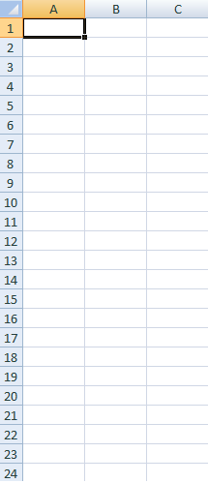
Spreadsheet Layout
Tabular layout arranged in rows and columns.
Columns are labeled with letters
Rows are labeled with numbers
Cells are at the intersection of rows and columns
Example cell reference: A3, C9
Cells can contain:
Numbers, dates, text, or other data
Formulas using functions and cell references

Slide 4
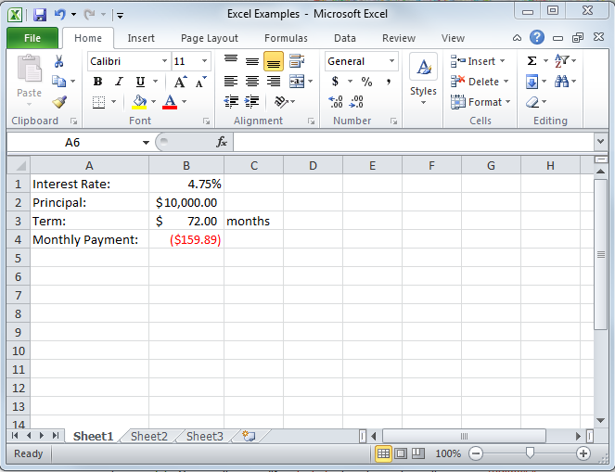
Microsoft Excel 2010

Slide 5
Cell Ranges
Many functions require cell ranges:
Column Range: A1:A10
Row Range: A5:K5
Matrix: A1:C5

Slide 6
Functions
Excel provide thousands of functions to build spreadsheet models:
Financial, e.g., pmt, irr, fv, db
Aggregation, e.g., sum, count, average
Text, e.g., left, mid, trim
Date & Time, e.g., today, time, second
Lookup, e.g., choose, vlookup, match
Logical, e.g., if, not, or
Statistical, e.g., median, correl
Engineering, e.g., bessel, imlog
Trigonometric, e.g., sin, tan, acos

Slide 7
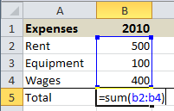
Entering Formulas and Functions
To enter formulas and functions:
start entry with =
Example:

Slide 8
Cell References in Functions
Most functions require parameters.
To keep your model flexible and correct even when the data changes, only use cell references in functions.

Slide 9
Copying Cells
To copy cells:
CTRL+C to copy and CTRL+V to paste
or
Use cell dragging
Cell references are automatically adjusted when copied.
Cell references can be locked $.
$A1:$A5 is not adjusted when column copied
A$1:C$1 is not adjusted when row copied
$A$1 is never adjusted when copied

Slide 10
Copying Formulas
Relative cell references adjust when copying:
Columns references adjust when copying across columns
Row references adjust when copying across rows
Generally, the adjustment is desirable, but sometimes it is not:
Lock cell references by making them absolute references
Use $ before row and/or columns for locking

Slide 11
Anchors and Cell Dragging
Formulas can be copied to adjacent cells by dragging.
Dragging changes cell references.
Usually this is what you want, but sometimes it breaks your formulas.
Anchors ($) stop cell references from changing.
But when do you use them?

Slide 12
When to Anchor
Manually rewrite your formula in the cell to the right and the cell below the original cell.
Compare the letters in the original formula to the letters in the formula to the right.
If a letter didn’t change, put a $ before it in the original cell.

Slide 13
When to Anchor
Manually rewrite your formula in the cell to the right and the cell below the original cell.
Compare the numbers in the original formula to the letters in the formula to below.
If a number didn’t change, put a $ before it in the original cell.

Slide 14
Demo: Copying Formulas
Notice what happens to the cell references when copying from row to row or column to column.
Observe the effect of cell locking with $.
Click to watch video demonstration

Slide 15
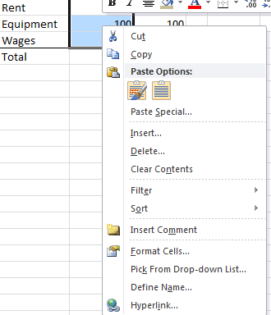
Named Ranges
To make your formulas easier to read, use named cell ranges.
To create a named range:
Highlight cells to include in named range
Click right mouse button on any cell in the selected range for context menu
Choose “Define Name…” and provide name
Note: named ranges are never adjusted when row or column copied, i.e. both cells and columns are automatically anchored in named ranges.
Click here to watch demonstration…

Slide 16
Named Ranges in Functions
Named ranges can make function parameters easier to understand:

Slide 17
Managing Named Ranges
To manage (delete, edit, rename, etc) named ranges
In the Formulas ribbon
Click on Name Manager

Slide 18
Managing Named Ranges

Slide 19
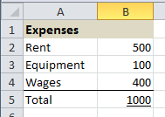
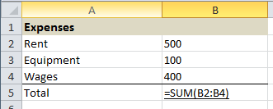
Showing Formulas
To show the formulas in your spreadsheet, press CTRL+~.

Slide 20
Formatting
Formatting changes the way values are displayed, but does not change the actual value being used in functions.
Common formatting options:
Currency values
Time and date values
Numeric formats and decimal points
Percent

Slide 21
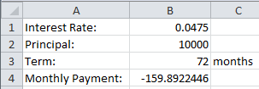
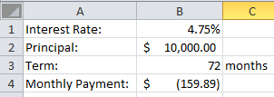
Demo: Formatting
Unformatted values
Percent
Currency
Accounting
Formatted values
Click here to watch demonstration…

Slide 22
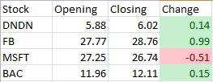
Conditional Formatting
Conditional formatting is allows the application of specified formatting only when certain conditions are met.
On the Home tab, in the Styles group, click the arrow next to Conditional Formatting

Slide 23
Rounding
Rounding actually changes the value by rounding up or down to some specified accuracy.
The rounded value is copied to another cell.
To round, use the ROUND() function:
=ROUND(A1,2)
=ROUNDUP(A1,2)
Notes:
Note the difference between rounding and formatting precision.

Slide 24
Formatting Example

Slide 25
Look Carefully at the Formatting Example
It appears to say that the sum of
3.05
2.02
1.03
is 6.11
That is not mathematically correct!
The next slide shows what is actually in each cell. (Control / ~)

Slide 26
Formatting Example with Control / ~

Slide 27
What happened?
What happened is that the cells in column ‘A’ were formatted to show only 2 digits after the decimal point.
However, the numbers in column ‘A’ actually had more than 2 digits after the decimal point. The last digits were “hidden”.
Hiding some of the digits can yield results that appear to be wrong.

Slide 28
Rounding Example

Slide 29
Rounding Example with Control / ~

Slide 30
Rounding Example
The addition in column ‘B’ is now mathematically correct.
The value that appears in cell B5 is in fact the sum of the numbers appearing in cells B1:B3

Slide 31
Warning!
The values displayed by a computer application are often not the values that are used inside that application.
If you need a value that has only a certain number of digits after the decimal place, you must round that value, not merely format it.
Excel: ROUND(Range, Decimal Places)

Slide 32
Bottom Line
If a computer’s arithmetic appears incorrect, it is may be a formatting / rounding error.
Excel: fix these errors with the ROUND function.

Slide 33
Hiding Columns or Rows
To make spreadsheets easier to read, you may wish to hide rows or columns that contain auxiliary (or supporting) values or temporary calculations.
Right-Click on the row or column header and select “Hide”.
Click here to watch demonstration…

Slide 34
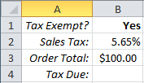
The IF Function
The IF function allows a cell to be filled with one of two possible values.
General form of IF:
=IF(condition,value_if_true,value_if_false)
Example:
Cell B4 is either $0 if the customer is tax exempt or the tax due is the order total multiplied by the tax rate.
=IF(B1="Yes",0,B2*B3)

Slide 35
Taking a Closer Look at IF
Does cell B1 contain “Yes”?
If so, then cell B4 will be filled with the value 0
If not, then cell B4 will be filled with the result of the formula B2*B3
=IF(B1="Yes", 0, B2*B3)

Slide 36
A Closer Look at the Statement
true
=IF( B1="Yes", 0, B2*B3)
false

Slide 37
How Does IF Work?
IF does not perform any calculation, it simply fills a cell with one of two values.
The values can be:
literals (actual numbers or text), e.g., 0
results of functions or formulas
empty cells ("") are two double-quotes
some cell reference, e.g., B2

Slide 38
The IF Condition
The IF condition is a logical expression, I.E. it evaluates to true or false.
Examples:
equality (=)
less than (<) or less than or equal (<=)
greater than (>) or greater than or equal (>=)
Complex conditions can be built with the AND and OR functions.

Slide 39
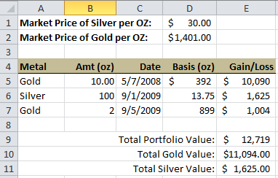
A Complete Spreadsheet Model
Spreadsheet to calculate the market value of a precious metals portfolio.
=B5*(IF(A5="Gold",$D$2,$D$1)-D5)
=SUM(E5:E7)
=SUMIFS(E5:E7,A5:A7,"Gold")

Slide 40
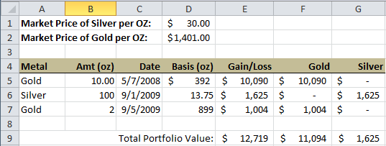
Filtering Data
An alternative way of summing data.
=IF($A5=F$4,$E5,0)
=SUM(F5:F7)
Try it out online with Zoho Sheet

Slide 41
COUNTIF
COUNTIF allows you to display the number of cells in a range whose values meets specific criteria.
The syntax of the COUNTIF function is: COUNTIF(range,criteria) … where range is a group of cells, and criteria is the value a cell must have to be counted.
The default operator for criteria is "equals" and should not be specified.
Operators ( >, <, >=, <=, <> and =) must be enclosed in quotation marks and <> means "not equal”.

Slide 42
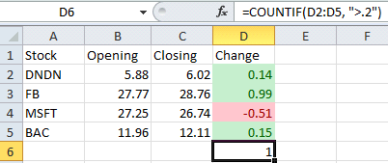
COUNTIF
Example:

Slide 43
Flexible Models
Excel Basics

Slide 44
Assume Data May Change!
It is best practice to write your spreadsheets in such a way that they give correct results for given data, regardless of what that data might be, and not merely the correct results for a particular data set.
If the data changes, the answer should be correct for the new data set.

Slide 45
Don’t Duplicate Data!
Since the given data for a problem may change, this data should appear as given data in one place only.
If data given for a problem is repeated in many places, then changing that data will require changes in many places.
This can be a source of errors as well as a source of unnecessary work.

Slide 46
Building Flexible Models
Don’t use actual numbers of text in your formulas and functions, i.e., don’t “hard code” values.
To keep your model general and flexible when data change, use only cell references.

Slide 47
Inductively Defined Problems
An inductively defined problem has 2 parts:
A set of starting conditions
A set of rules that describe how data changes from one step to the next.

Slide 48
Inductively Defined Problems
This is the starting condition
Example:
You deposit $1000 in a savings account
At the end of each year, you receive 4% interest on the balance in your account.
This rule describes how data changes from one step to the next

Slide 51
Inductively Defined Problems
The parameters of our problem appear separately from the calculations that model our problem (columns A and B).
There is a special year 0 in our solution that serves as a place holder for our starting condition.
The formulas for the data for each year other than year 0 are similar, differing only in the cells that they reference.

