Slide 1
Access Reports
Topic 16
Lesson 1 – Introduction to Access Reports
Microsoft Access

Slide 2
Reports
Reports are formatted query results
A report has physical sections where the query fields can be positioned
Access has two ways to create reports:
Custom Reports
Report Wizard
In both cases, you need a query that contains the information you want to put into the report.

Slide 3
The Orders Database
The database contains data for orders placed by customers.
For each order we collect what was ordered, how much of that item was ordered, and at what price.
For each order we track who placed that order.
For each customer (called a contact) we store where they live.
For each product that we sell we track the product’s description and price.

Slide 4
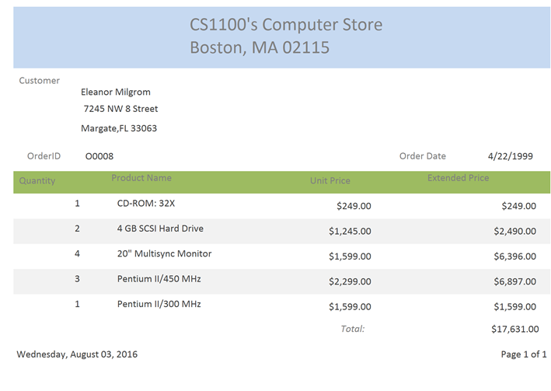
Desired final report layout
OrderId
may change: This will cause a change in the data but NOT a change in the report format

Slide 5
Parameterized Query
Allows user to input a specific value for a query.
E.g. ask user what name, zip code, product, etc. they would like information about.
In the criteria field, set an attribute that does not exist in any of the joined tables.
Access does not generate an error if it cannot determine a field, it assumes the user wants to create a new field that the user provides its value

Slide 6
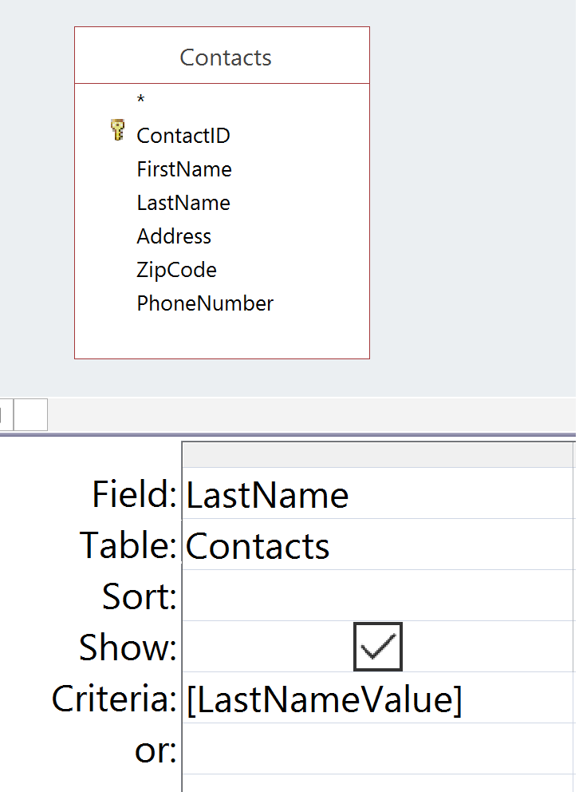
Parameterized Query
In the criteria field, set an attribute that does not exist in any joined tables.
When you run the Query, you will be asked to type in the Last Name value to match
Result

Slide 7
Designing the Query for the Report
What fields do we need for this report?
Choose the fields found/needed in the report
Report can perform aggregation on provided fields for final report
Save the query

Slide 8
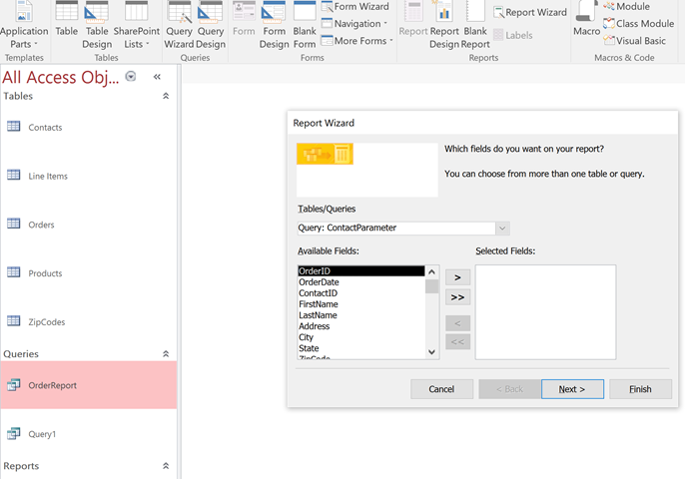
Report Wizard
Select saved query
Click on report wizard

Slide 9
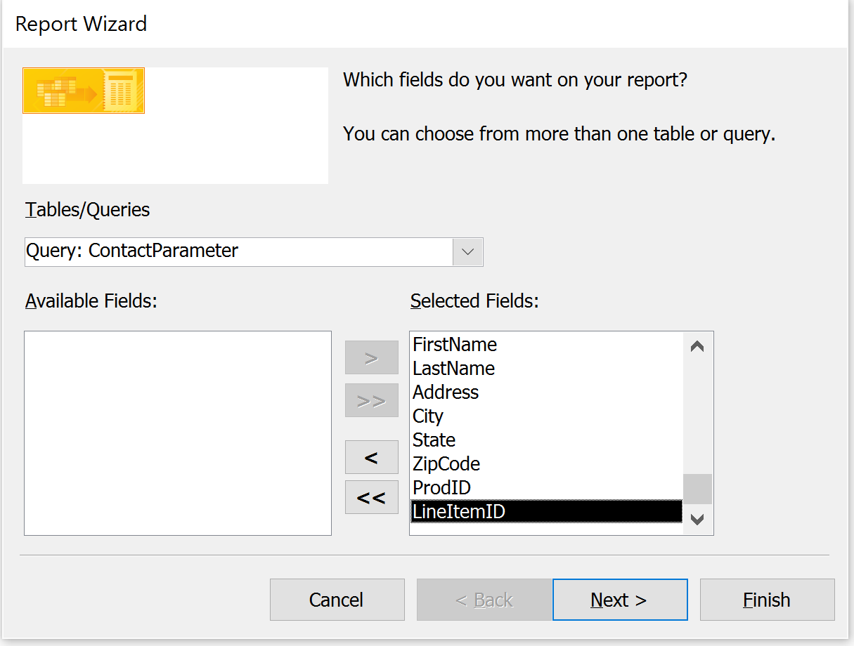
Report Wizard: Selecting Fields
Click the double arrow icon to include all fields in query
Verify the source for the report. If it is incorrect use the pull down menu to change the source
Click the Next button

Slide 10
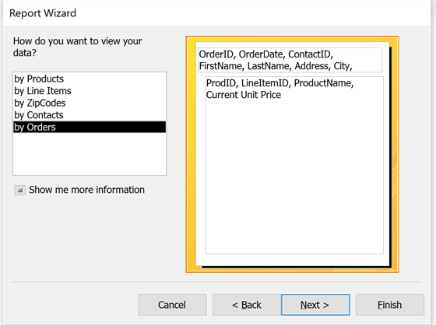
Grouping Data in Reports
Determine the grouping levels for displaying fields in the report. Here we can group by any table in the query. In this report we group by Orders since the report is specific for an order.
Click the Next button

Slide 11
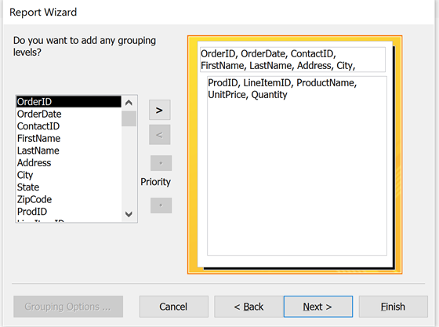
Grouping Levels in Reports
IGNORE ADDITIONAL GROUPING LEVELS
Click the Next button

Slide 12
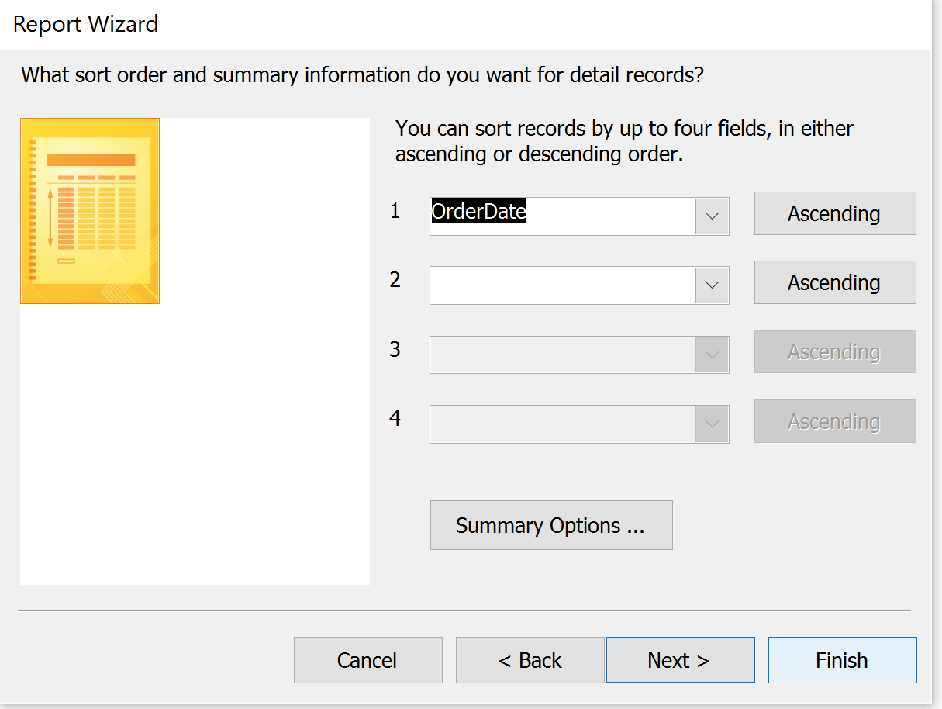
Ordering Data in Reports
10. Can choose to order detail records by a specific field. This can also be specified later when designing the report.
11. Click the Next button

Slide 13
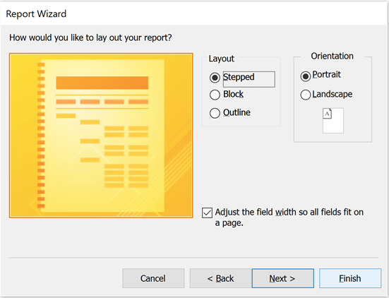
Specifying the Report Layout
12. Review the 3 layout options and choose the one needed for your report. Then choose the page orientation. These options can be changed later when designing the report.
13. Click the Next button

Slide 14
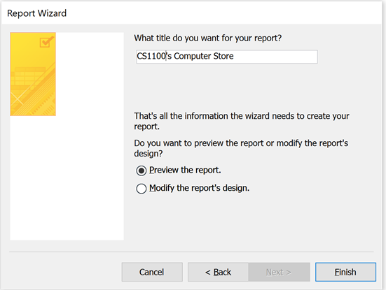
Naming the Report
14. Type in a name for the report. This can be changed later when designing the report. Choose to preview the report so you can create a plan for modifying the report layout.
15. Click the Finish button

Slide 15
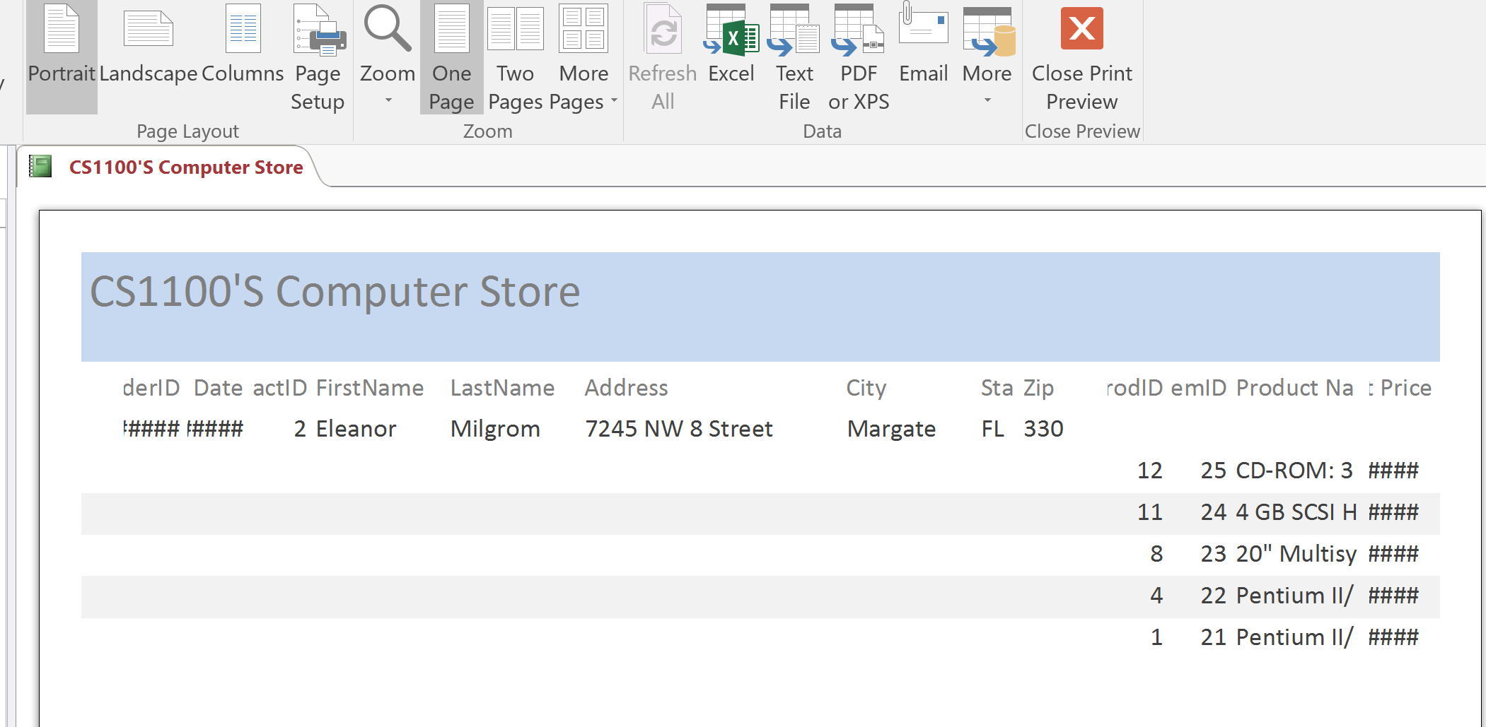
Preview the Report
From the report preview, identify the necessary changes you want to make.
Click on the ‘Close Preview’ icon, this takes you to the ‘Design Report’ View.

Slide 16
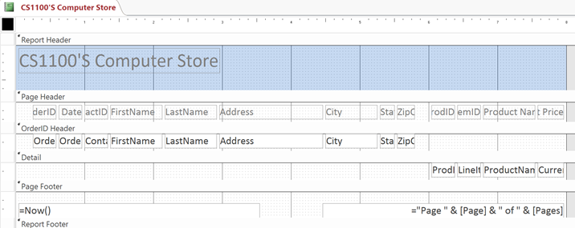
Report Design View
Report Sections
1. Report Header
Appears once at the top of the report
2. Page Header
Appears at the top of each page
3. OrderID Header
Appears once per Order.
4. Detail Section
Appears once per record in the result
5. Page footer
Appears at the bottom of each page
6. Report footer
Appears once at the bottom of the report
Once in the Report’s Design View:
Move (select and drag) boxes around to place items in the different report sections
Adjust the sizes of the different sections
Adjust the sizes of the different report items
View the field list
View the property sheets associated with the different report items
Create new groups and/or create headers/footers for existing groups

Slide 17
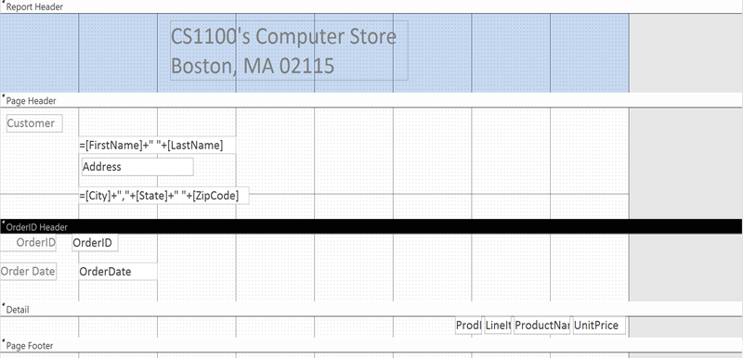
Changing the Report Design
Work section by section to improve the layout:
Change and center the label in the Report Header Section
Increase the page header section and create textboxes for the concatenated text fields
Choose the report items for the OrderID Header
Check the layout of the report after a few changes

Slide 18
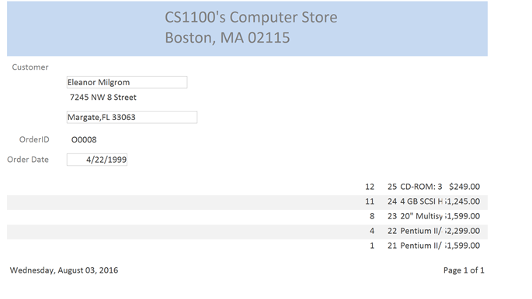
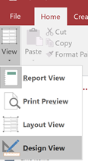
Review Changes in Report View
Remove outline of text box
Change background color
Fix layout in detail section
Switch back to the Report’s ‘Design View’ to continue making changes

Slide 19
Continue improvements in Design View
Remove outline of text box
Change background color
Fix layout in detail section

Slide 20
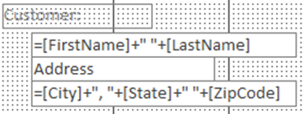
Rearranging the Report
Move items to where you want them.
Each item is a field plus an optional label.
Fields can contain “expressions”:
Create a new text box for each expression, do not reuse an existing one (will cause errors)
Names of fields
In the query

Slide 21
Customization with the Design Tab
Explore the Design tab features
Group & Sort
Add additional
Headers, footers, summaries etc.
Items to Add
Add report items such as labels, textboxes, checkboxes etc.
Field List
Provides complete list of all available fields for the report
Property Sheet
Select any item in the report and change any property for the item

Slide 22
Text Label vs. Controls
Note that there are two icons for adding “text” – they are NOT the same:
The Text Box allows you to add a field from the query; must be bound to a field
The Label allows you to add free-form text

Slide 23
Group/Sort/Total Features
Select More to display OrderID settings:
Select any dropdown to add/drop to group
Sort Order
With Totals
With Header
With Footer

Slide 24
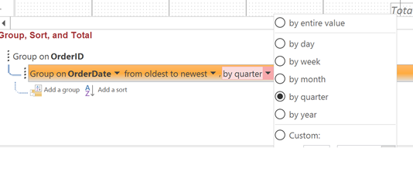
Grouping with a Date Field
When grouping by a date you can specify the grouping calendar metric
Choose ‘by entire value’ if you want to group by the calendar day
Default:
Roll data up by quarter when grouping by date

Slide 25
Aggregating Over Details
Now that you have added a footer to the group (OrderID) you can aggregate over the details of the group (Line Items).
Use aggregate functions (things available in the Total field of query design view) in Text Box expressions.

Slide 26
Report View of Aggregation
Continue to review your report in ‘Report View’
Some default properties may need to be changed for your report
For example, in our report we do not want defined borders on text boxes

Slide 27
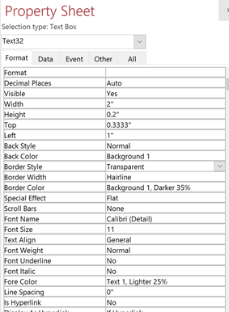
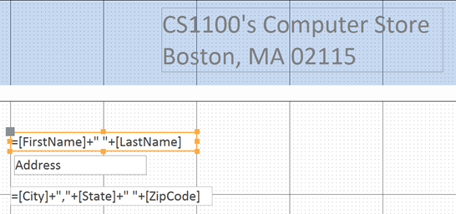
Use the Property Sheet to change the look of a Report Item
Remove the outline of the text box by setting the border style to transparent

Slide 28
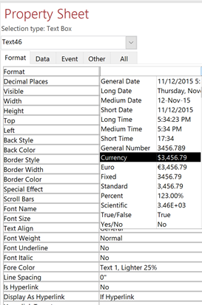
Use the Property Sheet to change the report item’s display format
Format is a PULL DOWN Menu.
Item selected.
Change display format to Currency

Slide 29
Format Tab allows you change common properties
As an alternative to the property sheet, the format tab provides a quick method for updating common properties for the selected report item
Font Properties
Data Properties
Shape Fill
Shape Outline

Slide 30
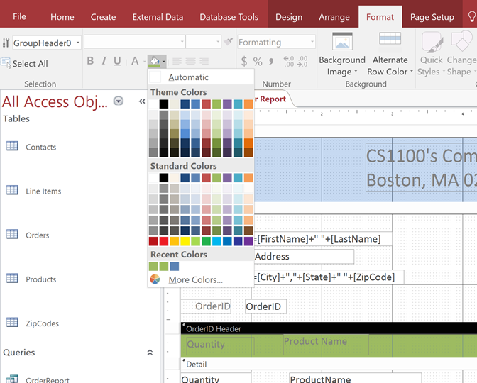
Changing Colors
1. Format Tab
3. Select a color
2. Click in the area

Slide 31
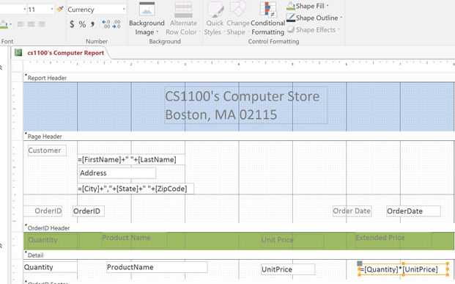
Formatting Values
In Design View, click on the field or area, then go to the Format tab. This is the same formatting pane as the one found in Excel.

Slide 32
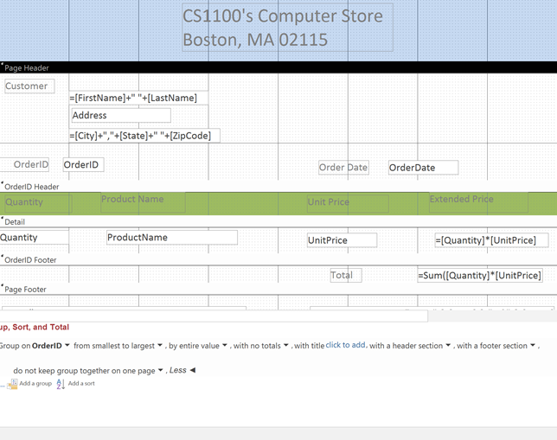
Design View for the final report

Slide 33
Report View of final report

Slide 34
Creating Reports in Excel
Rather than creating reports in Access, one could also use Excel to create reports, visualize data with charts, or perform analysis, perhaps through Pivot Tables and Charts.
Excel has the capability of directly linking to Access tables, so when the data changes the Excel reports, charts, and Pivot analysis is automatically updated.

Slide 35
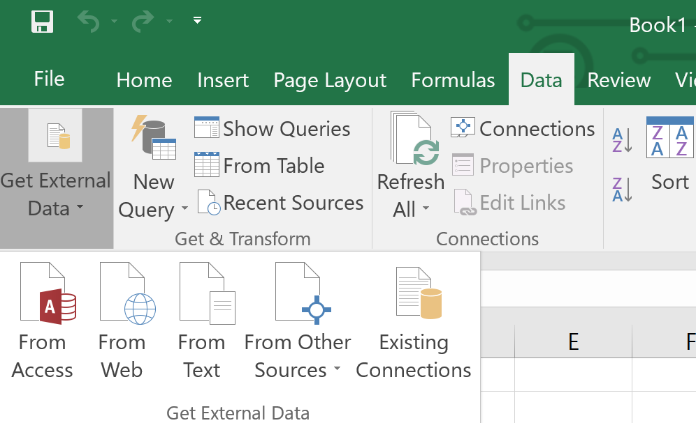
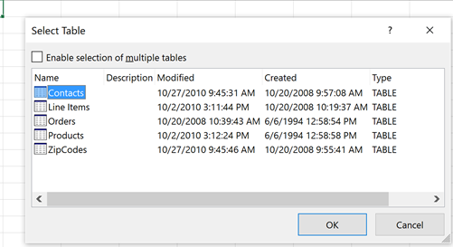
Create a Pivot Table from an Access Table
1. From Excel’s Data Tab, use the ‘Get External Data’ pulldown
2. Choose “From Access”
3. Find your Access file and choose the table or query to use in your pivot table.

Slide 36
Summary
Queries can have parameters.
Reports allow information technology professionals to provide data in a more readable format to users.
The Access Wizard creates reports based on queries.
The Report Designer allows reports to be designed using simple “drag-and-drop”.

